Slide 1

MBE LIAISON TRAINING
Presented by the
Governor’s Office of Small, Minority & Women
Business Affairs (GOSBA)
June 25, 2020
Governor’s Office of Small, Minority & Women Business Affairs

Slide 2
Webinar Housekeeping:
Please MUTE your microphone and TURN OFF video camera during the webinar!!
Confirm you are MUTED and the camera is TURNED OFF by hovering your mouse at the bottom of your screen in Google Meet to see the icons - RED means you are MUTED, but the camera is still ON in the example below. The two outside circles should be completely RED. (The center circle with the phone icon is the "hang up" button; if you click that one, you'll have to log back in!)
Please refrain from pressing any of the options on this bar in error such as record, captions or Present Now as this will disturb the webinar.
Use the CHAT bar on the side of the screen to submit questions, if you'd like. If questions are requested or once the speaker stops speaking, you may unmute and ask questions at that time.
During breaktime, please do not hang-up, this would cause a disruption when we resume.

Slide 3
AGENDA
Welcome & GOSBA Staff Introduction
Legislative Updates – Chantal Kai Lewis
Best Practices for Goalsetting / PRG – Chantal Kai Lewis
MBE Liaison Regulations & Duties – Nichelle Johnson
  Procurement Forecast
  MBE Strategic Plans
  60% Rule
  MBE Forms – Nichelle Johnson
  Quarterly/Annual Reporting & Best Practices
VSBE Update/Reporting – Tanita Johnson & Nichelle Johnson
Announcements
Upcoming Training Dates
Governor’s Office of Small, Minority & Women Business Affairs

Slide 4
Welcome!
Please Note:
The slide deck and recording will be available within a week after training on the GOSBA website.
Governor’s Office of Small, Minority & Women Business Affairs

Slide 5

Jimmy Rhee - Special Secretary
Pamela Gregory – Chief of Staff
Alison Tavik – Director of Communications & Outreach
Eduardo Hayden – Small Business Outreach Manager
Chantal Kai-Lewis – Legal & Policy Advisor
Lisa Mitchel Sennaar – SBR Compliance Manager
Tanita Johnson – SBR Compliance Manager
Nichelle Johnson – MBE Compliance Manager
Gerald Stinnett – MBE Compliance Manager – VLT Operations
GOSBA Staff
Governor’s Office of Small, Minority & Women Business Affairs

Slide 6

2020 LEGISLATIVE SESSION UPDATES
Chantal Kai-Lewis
Legal & Policy Advisor
Governor’s Office of Small, Minority & Women Business Affairs

Slide 7
MBE Program – Public–Private Partnerships, Offshore Wind Projects, and Video Lottery Terminals- HB313
Restored the applicability of the State’s MBE program to public-private partnerships (P3s) established under the current transportation title; and to offshore wind projects authorized in current law.
Current application of the MBE Program to construction projects and procurements related to video lottery terminals (VLTs) was extended for three additional years – until July 1, 2023.
MDOT must conduct a disparity analyses in order to establish MBE requirements for P3s and offshore wind energy projects.
Effective July 1, 2020; provisions related to P3s and offshore wind projects terminate June 30, 2023.

Slide 8
Task Force to Study the Veteran–Owned Small Business Enterprise Program – SB532
Staffed by DGS; comprised of internal and external representatives Task Force charged with studying and making recommendations regarding: opportunities for VSBE’s to participate in State contracts Improvement of the State’s VSBE program, including: increasing VSBE participation rates increasing oversight across participating State agencies boosting the overall program performance Submit recommendations to the Governor December 1, 2020.

Slide 9
2020 Legislative Update and Procurement Review Group (PRG)
Chantal Kai-Lewis
Legal & Policy Advisor
Governor’s Office of Small, Minority & Women Business Affairs

Slide 10
The Procurement Review Group:
THE DO’S & DONT’S
Governor’s Office of Small, Minority & Women Business Affairs

Slide 11
Procurement Review Group
Process for reviewing any:
  (a) Contract solicitations;
  (b) proposed sole-source contracts; and
  (c) proposed contract renewal options
Expected to exceed $200,000 in value in order to maximize opportunities for Minority Business participation
Group makes recommendations to the agency head and procurement officer concerning specific MBE contract goals and/or procurement methods.
Don’t automatically exempt emergency procurements or SBR procurements from MBE goal consideration

Slide 12
PRG Participants
There should be at least one or more standing procurement review group(s).
The group shall be comprised of:
  Agency’s chief procurement official or senior-level procurement official designated to act in his/her place
  MBE Liaison Officer or senior level alternate –
  Procurement units should expand the responsibilities of their MBE procurement review groups (see BPW Advisory 2001-2) to include a concurrent review of procurement solicitations for potential designation as small business reserve procurements.
Do rely on agency legal counsel to provide support and advice as necessary

Slide 13
GOALS
The statewide aspirational goal is 29%.
It is important to remember that this is an overall goal.
Individual contract goals must be considered on a contract-by-contract basis
DON’T put a blanket 29% goal on projects without a legitimate justification.

Slide 14
Subgoals
​​​Industry Category​​ | Subgoal​​​ ​ ​ ​
​​ | ​Women | African-American​ | Asian American​ | Hispanic​
Construction​ | ​N/A | ​7% | ​4% | ​N/A
Architectural/ Engineering & Construction Related Services​​ | ​9% | ​6% | ​N/A | ​2%
Maintenance​ | ​N/A | ​8% | ​3% | ​N/A
IT Services & IT Supplies​ | ​8% | ​7% | ​N/A | ​3%
Human, Cultural, Social & Education Services​ | ​12% | ​7% | ​4% | ​2%
​Supplies & Equipment | ​10% | ​6% | ​5% | ​N/A
DO use the subgoal worksheet and guidelines to apply subgoals as appropriate

Slide 15
Before Goalsetting
DO Consider Race Neutral Options (COMAR 21.11.03.07)
Race neutral methods are those that assist businesses without consideration of social, economic, race or gender
  Small Business Reserve
  Small Business Preference
  Divide larger procurements into several smaller procurements where feasible
  Directly notifying qualified small businesses including MBES
  Relaxed bonding requirements
  Simplifying bidding requirements to the extent permitted by law
  Pre-Solicitation Conferences
    Clarify complex solicitations
    Connect subs and primes

Slide 16
DO Identify Subcontracting Opportunities
Can the procurement be broken down into subcontracting opportunities:
  Scope of Work
  Engineer’s Estimate
  Previous compliance reports
  Similar procurements in size and discipline
List all possible subcontracting NAICS Codes on the PRG Form
  Are MBE’s available in the categories identified?
  Does it make sense geographically?
Does the contract structure support subcontracting?

Slide 17
Goalsetting & Counting
DO allow MBE Primes to self-perform 50% of an established contract goal; 100% of any subgoal
DO treat the MBE & VSBE Programs as mutually exclusive (dually-certified firms can count toward both program goals)
DON’T Forget to Consider the 60% Rule’s Impact on Goalsetting
e.g.: If supply purchase accounts for 5% of the overall contract value—the goal for that line item would compute to 3% to account for the 60% Rule.

Slide 18
Other PRG Requirements
DO send all PRGs for procurements expected to exceed $25M to GOSBA for approval
DO provide as much detail and context as possible on your PRG Determination (for historical purposes and protest)

Slide 19
PRG Scenario #1
SBR Dredging Company was a subcontractor to a large firm on a $5.0m dredging and tugboat project in 2019 and handled $1.5m worth of dredging work.
New dredging work arises in 2020 that is estimated at $3.0m, PRG is reviewing the scope and determines it is a good opportunity to designate this as an SBR, because they believe that there are enough small firms to bid on this work.
What is the best practice to put forth the solicitation:
to open market with no MBE goal
to open market with 3% VSBE goal
as SBR designation as SBR designation and accept winning bid with SBR naming a large subcontractor to perform 70% of the work
to open market with an MBE goal
as SBR designation with an MBE goal
As SBR designation
For Internal Training Purposes Only

Slide 20
PRG Scenario #2
Agency has the need for three Project Managers to handle a routine IT data migration project. Estimated cost is $100,000 over 2-year period.
What is the best practice to put forth the solicitation:
to open market with no MBE goal
to open market with VSBE goal
as SBR designated
to open market with an 20% MBE goal
as SBR designation with an MBE goal
For Internal Training Purposes Only

Slide 21
QUESTIONS?
Chantal Kai-Lewis chantal.kai-lewis@maryland.gov

Slide 22


MBE Liaison Regulations & Duties
Nichelle Johnson
MBE Compliance Manager
Governor’s Office of Small, Minority & Women Business Affairs

Slide 23

MBE Liaison Regulations
Code of Maryland Regulations (Last Updated: June 16, 2020)
Sec. 21.11.03.05. MBE Liaison Officer
The head of each procurement agency shall designate an employee to be an MBE liaison officer in the administration of that agency's minority business enterprise program. The MBE liaison officer shall be a high level employee reporting directly to a Secretary, Deputy Secretary, or head of a procurement agency. The MBE liaison officer is responsible for coordinating agency outreach efforts to the minority business community, reviewing agency contracting procedures to ensure compliance with this chapter, assisting in the resolution of contracting issues, and for submitting required MBE program reports or information.
Governor’s Office of Small, Minority & Women Business Affairs

Slide 24



MBE Liaison Duties
Highlights:
MBE Liaison needs to be designated.
Duties include:
Administration of the Agency’s MBE Program
  Coordinating Outreach Efforts
  Reviewing Agency Contracting Procedures
  Monitor Compliance with MBE Program
  Assist in resolving Contract issues
  Submitting required MBE Program Reports / Information
Governor’s Office of Small, Minority & Women Business Affairs

Slide 25

Contract Compliance
Basic Contract Compliance tasks should include review and tracking of the following items (Reports may or may not be prepared by the Liaison):
Pre Contract tasks (Reviewing Agency Contracting Procedures)
  Participation in Procurement Review Group
  Participate in Pre-bid Conferences
  Bid paperwork review (especially concerning MBE goals)
Post Contract Tasks (Monitor Compliance with MBE Program)
  Monitoring Contract Performance (as it relates to MBE utilization)
  Monitoring Contract Payments (to MBE firms)
  Participate in discussions on contract performance issues and assist with corrective action plans (this should be the Contract monitor, procurement officer and MBE Liaison)
  Review request to amend MBE participation schedules
Depending the liaisons position, they may or may not be involved in other contract and monitoring tasks.
Governor’s Office of Small, Minority & Women Business Affairs

Slide 26
Contract Compliance
Best Practices
To ensure that contracts progress as expected; MBE Liaisons should regularly review compliance to state procurement regulations, MBE utilization, and payment.
Compliance should be reviewed using the reports regularly received from Primes/Subcontractors. Agency contract compliance reports should be regularly generated by liaisons or contract monitor.
Issues that arise with contracts containing MBE goals should immediately be documented and escalated as needed.
Often mediation-like meetings, formal written requests to resume adherence to contract stipulations, and liquidated damages are used to prompt contractors to maintain compliance.
Governor’s Office of Small, Minority & Women Business Affairs

Slide 27
Reporting Requirements
Code of Maryland Regulations (Last Updated: September 18, 2019)
Sec. 21.11.03.17. Reporting
A. Each procurement agency shall make a report annually within 90 days following the close of the fiscal year to the Governor's Office of Small, Minority & Women Business Affairs, the Department of Transportation, and, subject to State Government Article, §2-1246, Annotated Code of Maryland, to the Joint Committee on Fair Practices and State Personnel Oversight that includes:
(1) The total number, value, and procurement category of its procurements from State-certified MBEs as prime contractors, and separately as subcontractors, by business name and specific MBE classification;
(2) The percentages, by specific classification of minority business enterprise, that purchases under §A(1) and (2) of this regulation represent of the total number and value of its procurements for the fiscal year just ended;
(3) The number of waivers granted pursuant to Regulation .11 of this chapter; and
(4) An evaluation by the procurement agency of the success of its MBE program, which evaluation shall include a brief description of the procurement agency's outreach efforts to MBE prime contractors and MBE subcontractors.
B. Each procurement agency shall submit to the Board of Public Works and the Governor's Office of Small, Minority & Women Business Affairs by July 31 of each year the report of waivers required under Regulation .11E of this chapter.
C. Each procurement agency shall furnish any other information or periodic reports requested by the Governor's Office of Small, Minority & Women Business Affairs or the Department of Transportation in connection with MBE certification and procurement, or any other matters related to the administration, effectiveness, or continuation of the Minority Business Enterprise Program.
D. The Governor's Office of Small, Minority & Women Business Affairs shall prepare an annual report summarizing certified MBE participation throughout the State, for submission by the end of each calendar year to the Board of Public Works, the Legislative Policy Committee of the Maryland General Assembly, and to each procurement agency.
Governor’s Office of Small, Minority & Women Business Affairs

Slide 28
Reporting Requirements
Maryland State Government Section 2-1246, Article - State Government § 2-1246.
(a) Each official or unit of the State government shall submit to the Department a list of the reports and other publications that the official or unit issues and intends to distribute or submit to the General Assembly or to any committee, staff agency, or employee of the General Assembly.
(b) An official or unit:
(1) shall submit to the Department 5 copies of each report that the official or unit intends to distribute or submit to the General Assembly or to any committee, staff agency, or employee of the General Assembly; and
(2) may give the report to a member of the General Assembly only if:
(i) the President and the Speaker have given written approval for distribution of the report to each member of the General Assembly; or
(ii) the member asks for the report.
(c) The Department shall:
(1) keep a list of the publications of the officials and units;
(2) periodically send the list to each member of the General Assembly; and
(3) on request of a member of the General Assembly, obtain a publication of an official or unit for the member.
(d) (1) The Department shall index and preserve the publications that officials and units submit as required by law.
(2) The Department may collect, index, and preserve any other publication that the Department considers necessary.
Governor’s Office of Small, Minority & Women Business Affairs

Slide 29
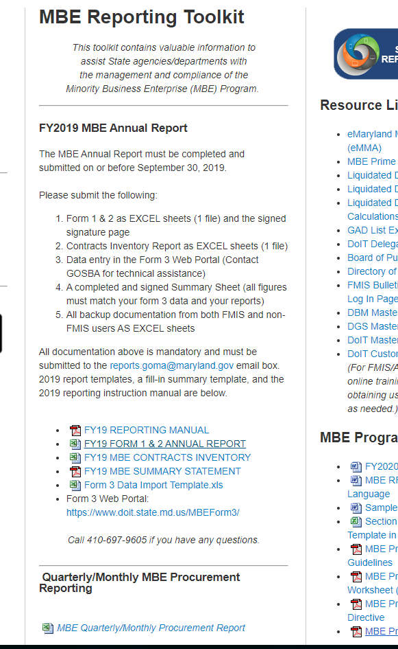
Use the Toolkit
Use the MBE Toolkit to retrieve all of the latest documents for reporting purposes!
Governor’s Office of Small, Minority & Women Business Affairs

Slide 30
Procurement Forecast
Used to report Agencies projected purchases of $100,000 and above for upcoming fiscal year. The published forecast is also a tool used by the Business Community.
Please be sure to included contact information for each projected purchase. If we are contacted, we will give out Liaison contact information to the business owners.
Plans are due by June 30th
Updated Forecast templates have been in the toolkits since April 2020.
Governor’s Office of Small, Minority & Women Business Affairs

Slide 31
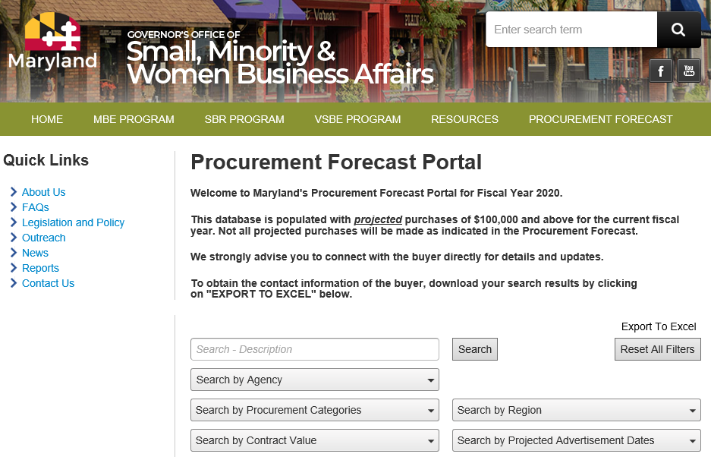

Slide 32
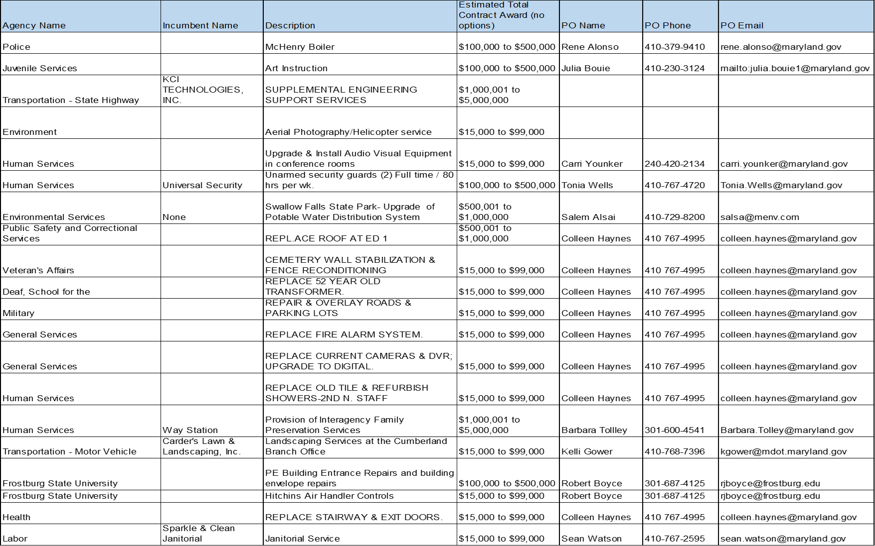

Slide 33
Strategic Plan
Used to help Agencies analyze their prior MBE efforts and develop a plan for the new Fiscal Year to continue and increase efforts to engage Minority and Women-Owned Businesses.
Reminders:
  Think outside of the box! In our new landscape, we must think of more creative ways to direct solicit to MBE firms.
  Provide as much detail as you can.
  Plans due by June 30th
  Submissions will only include up to Quarter 3 of the current Fiscal Year to alleviate issues with retrieving 4th Quarter data.
Governor’s Office of Small, Minority & Women Business Affairs

Slide 34

BREAK TIME
Please stay tuned, we will return shortly from our break.
Get in a quick stretch, get some coffee or cola, or rest your eyes.
Governor’s Office of Small, Minority & Women Business Affairs

Slide 35

The 60% Rule
The Rationale:
  In a narrowly tailored program, it is important that MBE credit be awarded only for work actually being performed by the MBEs themselves and that we’re not claiming that minority firms are actually getting the benefit
  MBE must be performing a commercially useful function [defined as when a firm is responsible for execution of the work of the contract and is carrying out its responsibilities by actually performing, managing, and supervising the work involved]
Governor’s Office of Small, Minority & Women Business Affairs

Slide 36
Understanding the 60% Rule
Chapter 438, Laws of Maryland 207 (SB 309)
Became effective Oct. 1, 2017
Mirrors Federal DBE rules, which define how work performed by DBE suppliers will be counted towards the overall project MBE goal
Discusses 3 Supplier Classifications:
  MANUFACTURERS
  REGULAR DEALERS/ AND OR WHOLESALERS
    *FURNISH & INSTALL & OTHER SERVICES*
  BROKERS
Governor’s Office of Small, Minority & Women Business Affairs

Slide 37
Manufacturers
100% of materials or supplies obtained from an MBE manufacturer, may be counted toward MBE goal achievement
What is a manufacturer?
  A firm that operates or maintains a factory or establishment that produces, on the premises, the material, supplies, articles or equipment required under the contract and the general character described by specifications
Governor’s Office of Small, Minority & Women Business Affairs

Slide 38
Regular Dealer
60% of the material or supplies purchased from a regular dealer count toward the project’s overall MBE goal
What is a regular dealer?
  A firm that owns, operates, or maintains a store, warehouse, or establishment, in which the materials, supplies articles or equipment of the general character described by the specifications and required under the contract are bought, kept in stock, and regularly sold or leased to the public in the usual course of business.
Governor’s Office of Small, Minority & Women Business Affairs

Slide 39
Furnish & Install Services
Where an MBE supplier, wholesaler, regular dealer, both provides (i.e., furnishes) AND installs the materials, 100% of the cost of the materials, supplies and labor will count toward the MBE goals.
EXAMPLE
  PAINTER – a wholesale merchant, who maintains a warehouse where he/she regularly keeps in stock and sells paint to prime contractors. Only 60% of the spend with this PAINTER can be counted toward the overall goal of the project
  PAINTER that PAINTS- same scenario as above, except the painter, in additional to selling the paint from their warehouse, will be responsible for doing the actual painting. In this case, we would count 100% of the cost of the material, supplies, and the service toward the MBE project goal.
Governor’s Office of Small, Minority & Women Business Affairs

Slide 40
Broker
Count the entire amount of:
  fees or commissions charged for assistance in the procurement of the materials and supplies; or
  fees of transportation charges for delivery of materials or supplies required on job site
Caveat
  Fees must be reasonable and not excessive as compared with fees customarily allowed for similar services
  Do not count any portion of the cost of materials or supplies themselves
Governor’s Office of Small, Minority & Women Business Affairs

Slide 41

MBE Forms
We will discuss
MBE Utilization and Fair Solicitation Affidavit and MBE Participation Schedule
Waiver Guidance
Good Faith Efforts Documentation
MBE Outreach Efforts Compliance Statements
MBE Subcontractor Project Participation Certification
MBE Prime Contractor Participation Certification
Governor’s Office of Small, Minority & Women Business Affairs

Slide 42
Regulations
Code of Maryland Regulations (Last Updated: September 18, 2019)
Sec. 21.11.03.09. Procurement Solicitations
(3) On forms provided by the procurement agency, a bidder or offeror shall submit with its bid or proposal:
(a) A completed MBE utilization and fair solicitation affidavit including either an agreement to meet the certified MBE participation goal or a request for a full or partial waiver; and
(b) A completed MBE participation schedule that identifies the certified minority businesses that the bidder or offeror agrees to utilize in the performance of the contract and the percentage of contract value attributed to each MBE.
(4) The MBE participation schedule shall:
(a) Include the name of each certified MBE that will participate in the project including the certification category under which the MBE is participating; and
(b) Include the percentage of the contract to be paid to each MBE for the work or supply.
(5) The failure of a bidder to accurately complete and submit the MBE utilization affidavit and the MBE participation schedule shall result in a determination that the bid is not responsive unless the inaccuracy is determined to be the result of a minor irregularity that is waived or cured in accordance with COMAR 21.06.02.04.
(6) The failure of an offeror to accurately complete and submit the MBE utilization affidavit and the MBE participation schedule shall result in a determination that the proposal is not reasonably susceptible of being selected for award unless the inaccuracy is determined to be the result of a minor irregularity that is waived or cured in accordance with COMAR 21.06.02.04.
Governor’s Office of Small, Minority & Women Business Affairs

Slide 43

MBE Utilization and Fair Solicitation Affidavit & MBE Participation Schedule
Must be submitted with the bid/proposal
Failure to submit results in the rejection of bid/proposal
Indicates Primes clear intent to either meet the goal or request a waiver of some or all of the goal(s)
Must provide specific commitment to each named MBE
Each named MBE must be fully certified (not pending) and not graduated
Must describe the specific work each MBE will perform
Work performed by MBE subs can only be counted if MBE is performing a commercially useful function
When MBE prime indicates intent to self-perform a portion of subcontract goal(s):
  Work to be self-performed must be covered by at least one of MBE’s NAICS codes
Governor’s Office of Small, Minority & Women Business Affairs

Slide 44
MBE Utilization and Fair Solicitation Affidavit & MBE Participation Schedule (cont.)
PART 2 - MBE UTILIZATION AND FAIR SOLICITATION AFFIDAVIT
  1. MBE Participation (PLEASE CHECK ONLY ONE)
  ☐ I acknowledge and intend to meet IN FULL both the overall certified Minority Business
  Enterprise (MBE) participation goal of percent and all of the following subgoals:
      ____percent for African American-owned MBE firms
      ____percent for Hispanic American-owned MBE firms
      ____percent for Asian American-owned MBE firms
      ____percent for Women-owned MBE firms
  Therefore, I am not seeking a waiver pursuant to COMAR 21.11.03.11. I acknowledge that by checking the above box and agreeing to meet the stated goal and subgoal(s), if any, I must complete PART 3 - MBE Participation Schedule and Part 4 Signature Page in order to be considered for award.
  OR
  ☐ After making good faith outreach efforts prior to making this submission, I conclude that I am unable to achieve the MBE participation goal and/or subgoals. I hereby request a waiver, in whole or in part, of the overall goal and/or subgoals I acknowledge that by checking this box and requesting a partial waiver of the stated goal and/or one or more of the stated subgoal(s) if any, I must complete Part 3, the MBE Participation Schedule and Part 4 Signature Page for the portion of the goal and/or subgoal(s) if any, for which I am not seeking a waiver, in order to be considered for award. I acknowledge that by checking this box and requesting a full waiver of the stated goal and the stated subgoal(s) if any, I must complete Part 4 Signature Page in order to be considered for award.
Governor’s Office of Small, Minority & Women Business Affairs

Slide 45
Waiver Guidance and Good Faith Efforts Documentation
Waiver Guidance - lays out main criteria used to determined good faith efforts
  Considers quality, quantity and intensity of bidder’s efforts
  Does not cover all factors state may consider
  Guidance covered on pp. D11 – D14 of MBE Attachment D
Good Faith Effort Documentation - must be submitted within 10 working days of request
  Implied Waivers
  Additionally, any MBE utilization affidavit or MBE participation schedule submitted by an apparent successful bidder or offeror that does not include a commitment to achieve the contract goal and any subgoals for MBE participation is now construed under the revised regulation as an implied request for a full or partial waiver of the remainder of the contract goal or subgoals, as applicable. The apparent successful bidder or offeror would then be required to submit documentation supporting that waiver request as provided in Regulation .11.
  Agency’s MBE liaison officer and legal counsel should be consulted on minor irregularity determinations and waiver issues prior to seeking GOSBA’s weigh in.
Governor’s Office of Small, Minority & Women Business Affairs

Slide 46
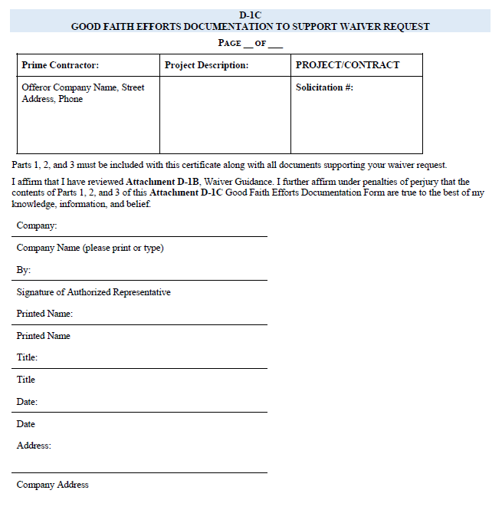
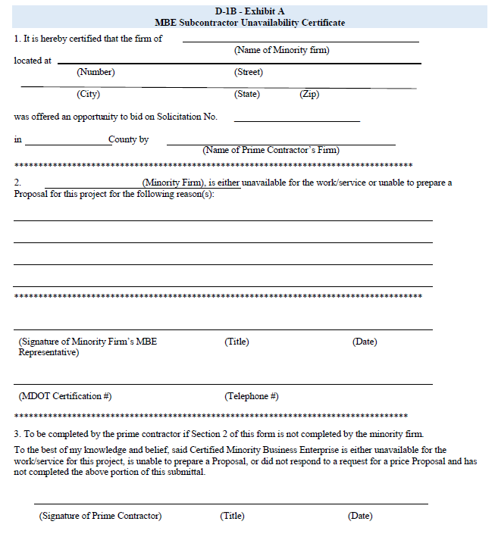
Waiver Documentation
D15
D16
Governor’s Office of Small, Minority & Women Business Affairs

Slide 47
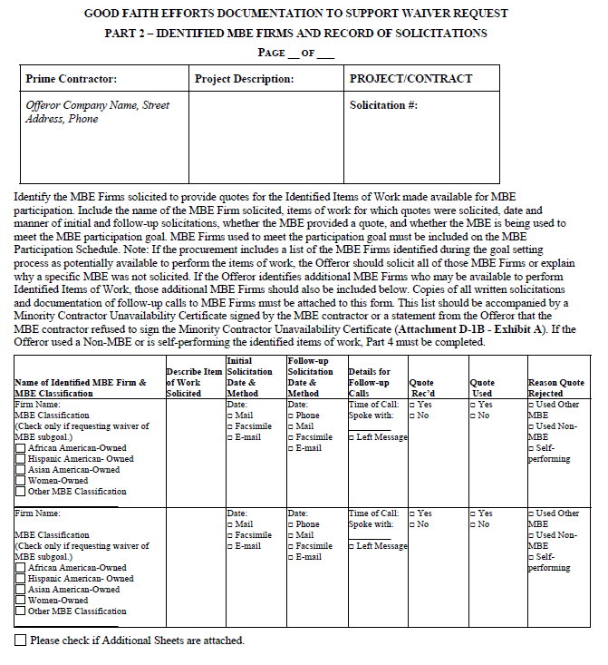
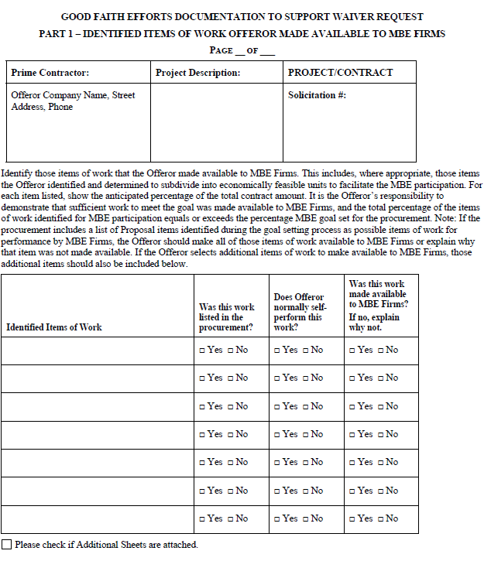
Waiver Documentation
(cont.)
D17
D18
Governor’s Office of Small, Minority & Women Business Affairs

Slide 48
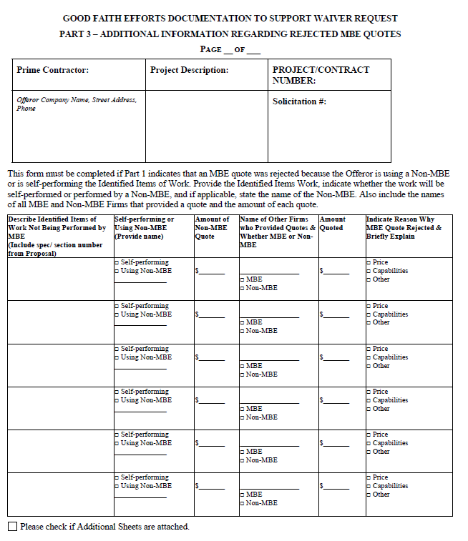
Waiver Documentation (cont.)
D19
Governor’s Office of Small, Minority & Women Business Affairs

Slide 49

Outreach Efforts Compliance Statement
Not required to be submitted with bid/offer
Requested from procurement officer in connection with notice of intent to award
Asks for bidder’s MBE outreach efforts and attempts made to assist MBE subcontractors
Reasonable timeframe to submit (10 working days)
Failure to submit this form could result in withdrawal of offer (see pg. 5 of Affidavit)
Governor’s Office of Small, Minority & Women Business Affairs

Slide 50
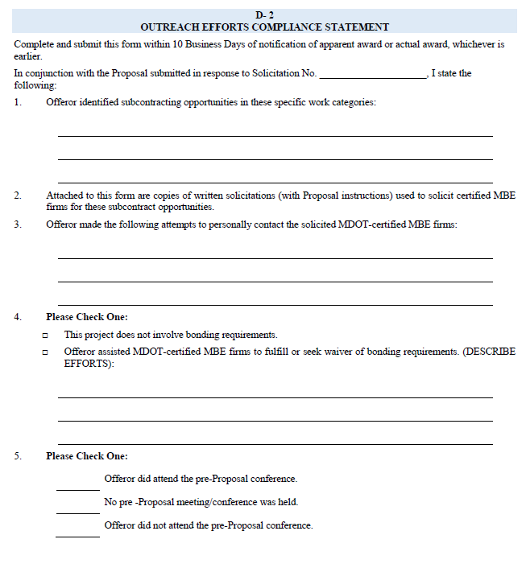
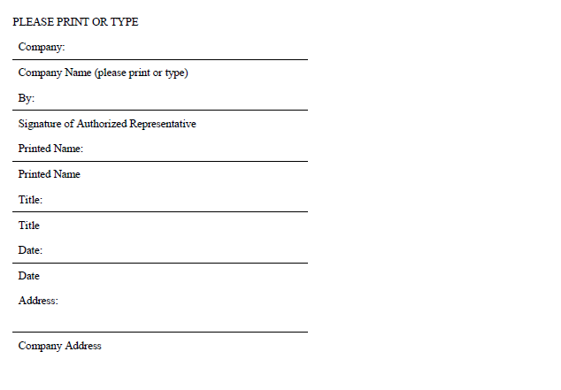
Outreach Efforts Compliance Statement (cont.)
D20
D21
Governor’s Office of Small, Minority & Women Business Affairs

Slide 51
MBE Project Participation Certifications
MBE Subcontractor Project Participation Certification
Must submit one for each named MBE within 10 working days
Prime must complete and sign this form before presenting to subcontractor for signature, note the fraud provisions on this form
MBE names, dollar amounts, percentages, and work descriptions must be consistent with Utilization Affidavit
Subcontractors should verify information on form before signing it; use this opportunity to finalize contract (T&Cs)
Procurement officer and MBE liaison should answer questions, if any arise
A copy should be held by the Subcontractor, Prime, and the Agency
Governor’s Office of Small, Minority & Women Business Affairs

Slide 52
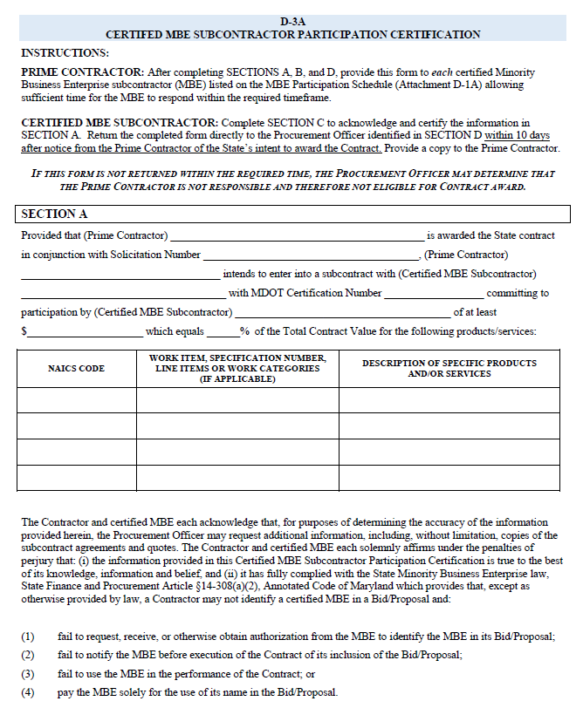
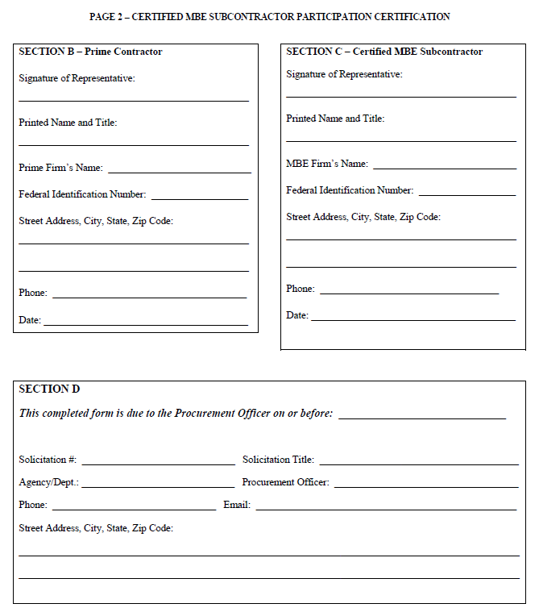
MBE Forms - Subcontractor
D22
D23
Governor’s Office of Small, Minority & Women Business Affairs

Slide 53
MBE Project Participation Certifications
MBE Prime Project Participation Certifications
Separate attestation for MBE prime self-performance
Entries here must be consistent with Affidavit/Schedule
Confirms that a specified percentage of work will be performed by MBE prime’s own workforce
Work must be within NAICS codes and fulfill commercially useful function
Subject to confirmation via field inspections, office visits, etc.
Governor’s Office of Small, Minority & Women Business Affairs

Slide 54
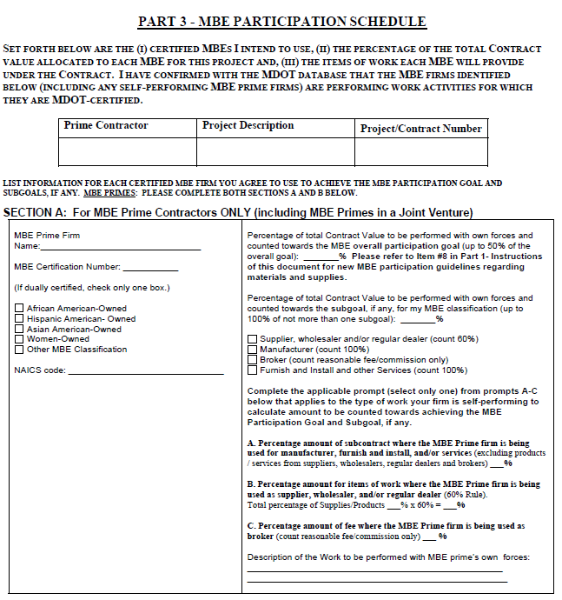
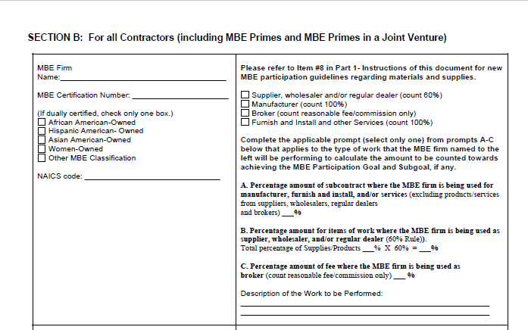
MBE Forms - Prime
D7
D8
Governor’s Office of Small, Minority & Women Business Affairs

Slide 55
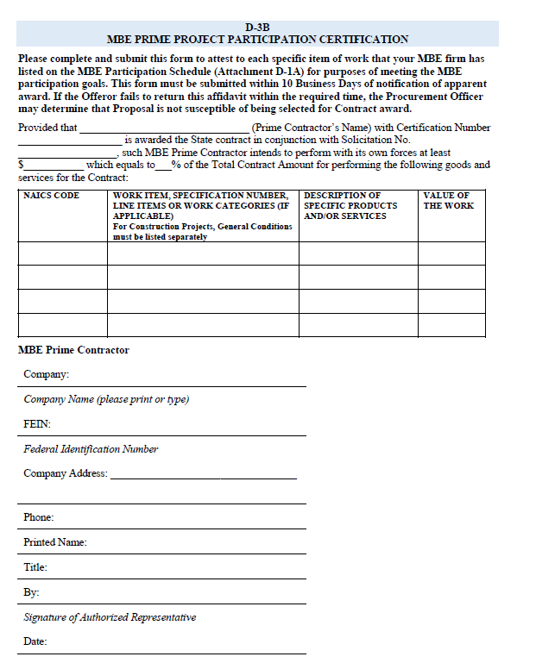
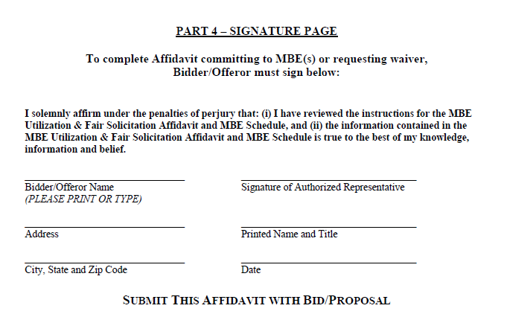
MBE Forms - Prime
D10
D24
Governor’s Office of Small, Minority & Women Business Affairs

Slide 56
Quarterly & Annual Reporting
Governor’s Office of Small, Minority & Women Business Affairs

Slide 57

MBE Reporting Best Practices
  Reports need to be submitted in Excel for importing into database. Why?
    Combined data is transformed into metrics
      Measures our success
      Allows us to see trends (positive or negative)
  Timely data submissions. Why?
    Allows GOSBA time to review data for errors
    Allows timely publication of the
    legislatively mandated annual report.
Governor’s Office of Small, Minority & Women Business Affairs

Slide 58
MBE Reporting Best Practices (cont.)
  Review the latest FY Reporting Manual to refresh your memory and make note of any changes before completing your reports.
  Prepare your report as soon as possible in case some corrections are required.
  Use only the latest templates posted in the MBE Toolkit for your reports: https://gomdsmallbiz.maryland.gov/Pages/Reporting-Tool-MBE.aspx
  Provided backup data with your report submissions.
  In addition to backup data, every report should contain Form 1/2, Form 3 submission summary, Contract Inventory Sheet, and SIGNED summary statement.
  Contact Nichelle Johnson immediately with questions
Governor’s Office of Small, Minority & Women Business Affairs

Slide 59
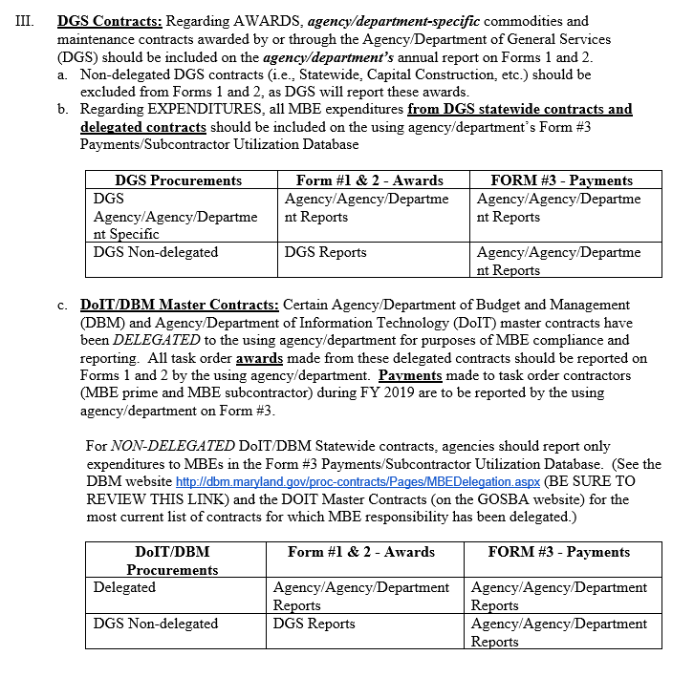
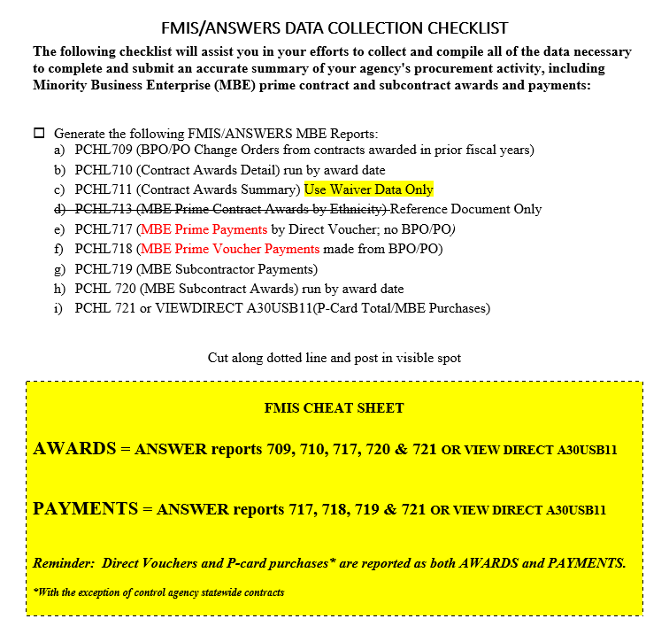
Source Documents
Governor’s Office of Small, Minority & Women Business Affairs

Slide 60
Important Note:
As of October 1, 2019, delegated procurements under the control agencies of the Departments of General Services, Budget and Management, and Information Technology move under the delegated control of the Department of General Services Office of State Procurement.
Governor’s Office of Small, Minority & Women Business Affairs

Slide 61
MBE Quarterly Report
Use the Quarterly Form 1 / 2 only. Found in the MBE Reporting toolkit, scroll down to see it.
Same general rules as Annual Report, except you include payment data broken down by MBE Classification on Form 2 and total payments to all PRIMES on Form 1.
Governor’s Office of Small, Minority & Women Business Affairs

Slide 62
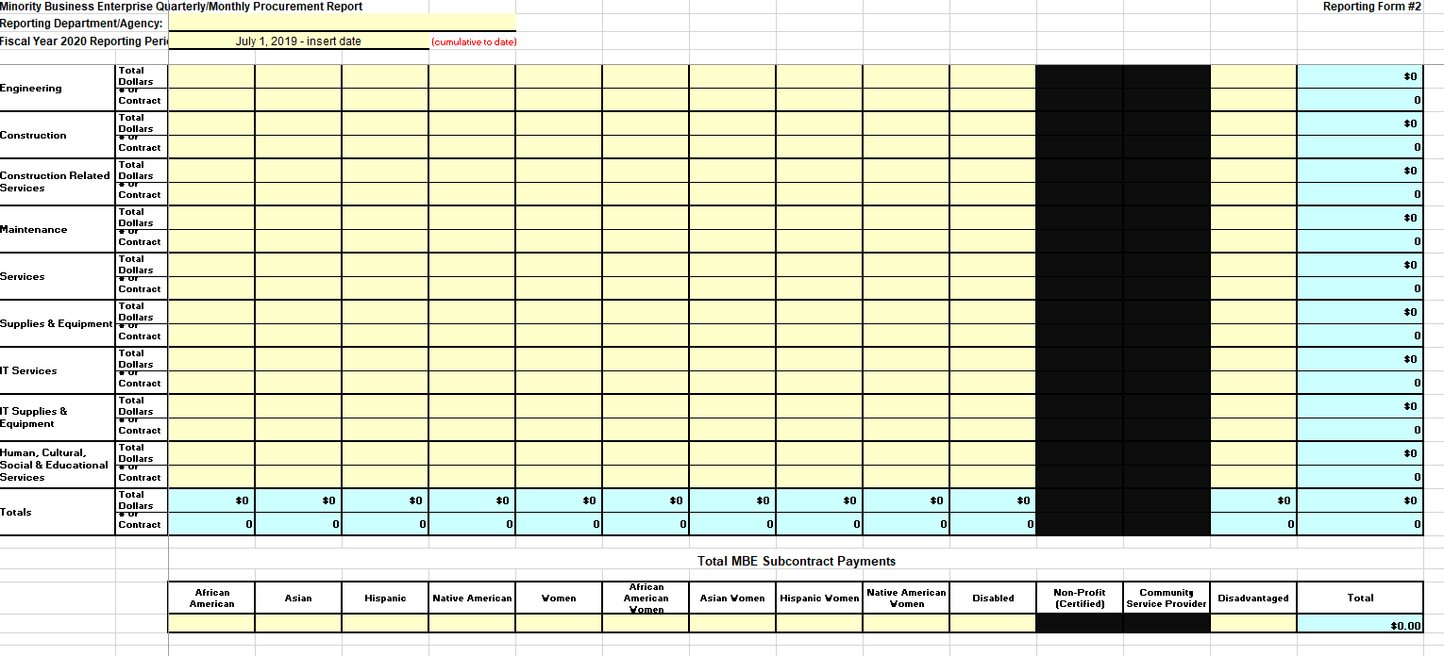
Form 2 Quarterly
Governor’s Office of Small, Minority & Women Business Affairs

Slide 63
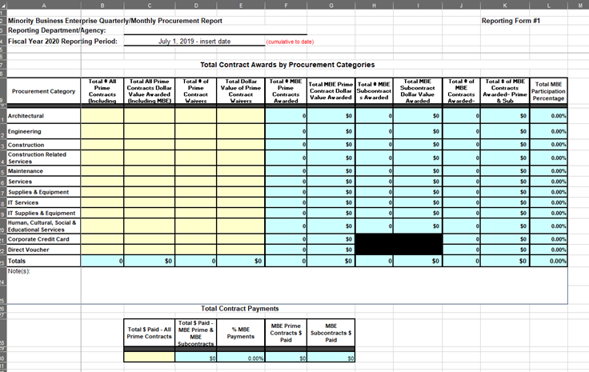
Form 1 Quarterly
Governor’s Office of Small, Minority & Women Business Affairs

Slide 64

Form 1 / 2 Annual Report
Use the Annual Form only. Found in the MBE Reporting toolkit with the rest of the Annual Report templates and Manual.
Prepare Form 2 First, data will link to the Form 1 cells in blue.
Direct Vouchers and Credit Cards are considered both an Award and Payment and should therefore appear on Form 1 / 2 and Form 3.
Do not double count payments – If entire contract is listed under a PRIME, do not include it in the subcontractor section (such as in the case of a self performing prime).
Do not put negative figures in Form 1 / 2.
If RED errors or codes appear in column M when you complete your report, that means something is incorrect, review and, if needed, call GOSBA for help. No percentage line can be more than 100% in column L.
Governor’s Office of Small, Minority & Women Business Affairs

Slide 65
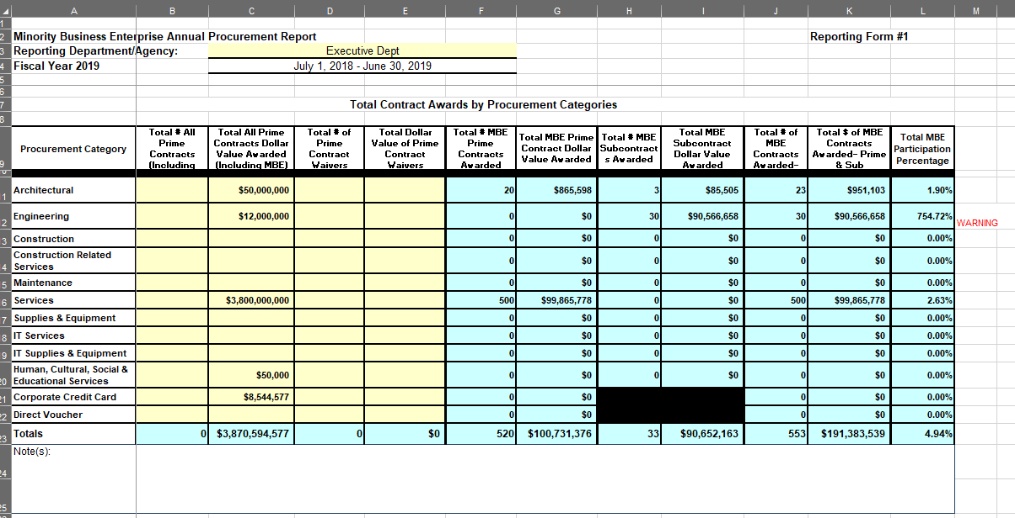
Form 1 Annual
Governor’s Office of Small, Minority & Women Business Affairs

Slide 66
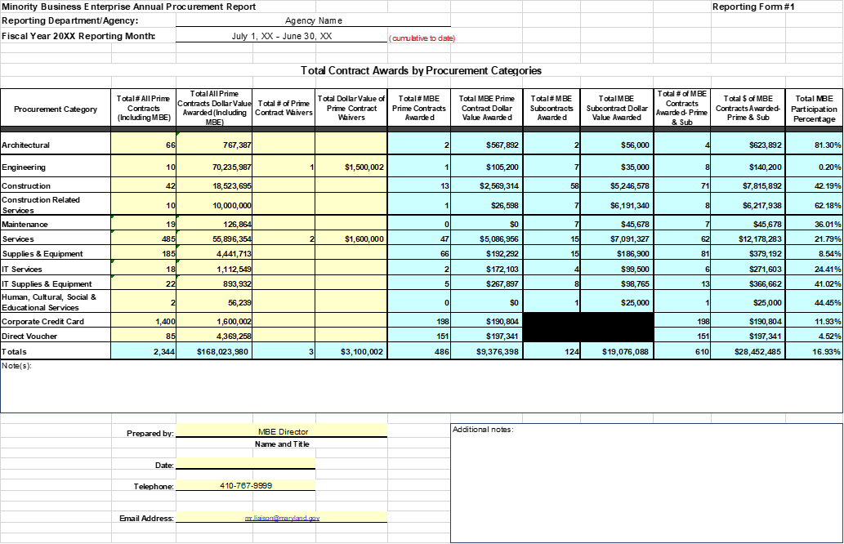

A Well Completed Form 1
Pat Harrison,
09/15/2019
Governor’s Office of Small, Minority & Women Business Affairs

Slide 67
Form 3 Web Portal - Data Entry
https://doit.state.md.us/MBEFORM #3/
Retrieve login info from GOSBA, if needed.
Choose your method
  Manual Entry OR
  Import Template
Be mindful, if you are using the import method, it will overwrite everything currently in working data.
Manual entry requires that you delete expired contracts, update contracts from prior years with new payment data, and enter new contracts/payments
No matter what method you choose, you must still submit for the reporting year. Problems with submitting, contact GOSBA: 410-697-9605
Governor’s Office of Small, Minority & Women Business Affairs

Slide 68
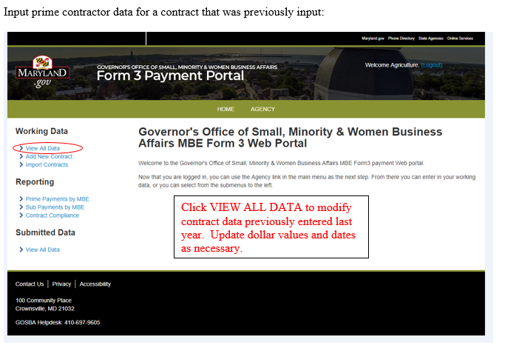
Form 3 Portal - Manual Entry
Governor’s Office of Small, Minority & Women Business Affairs

Slide 69
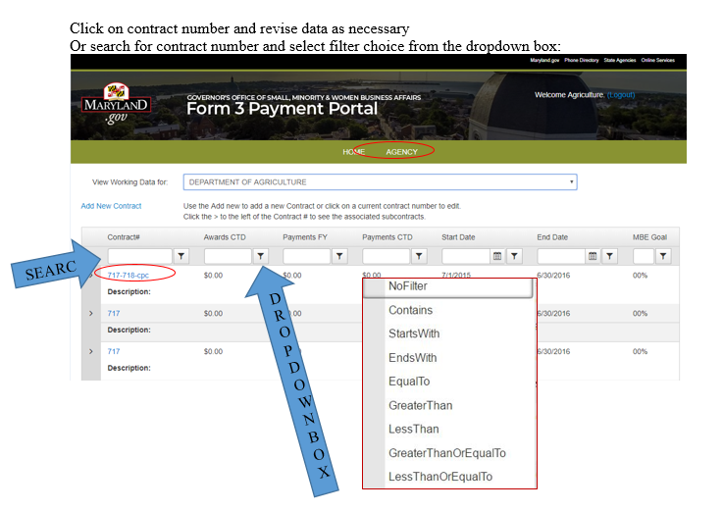
Form 3 Portal - Manual Entry
Governor’s Office of Small, Minority & Women Business Affairs

Slide 70
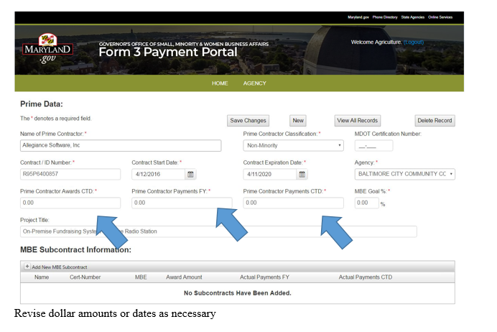
Form 3 Portal - Manual Entry
Governor’s Office of Small, Minority & Women Business Affairs

Slide 71
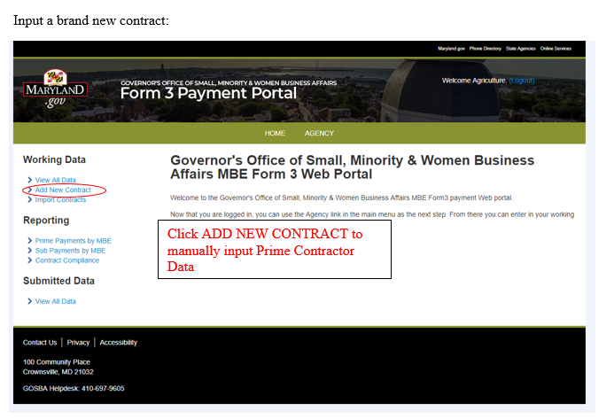
Form 3 Portal - Manual Entry
Governor’s Office of Small, Minority & Women Business Affairs

Slide 72
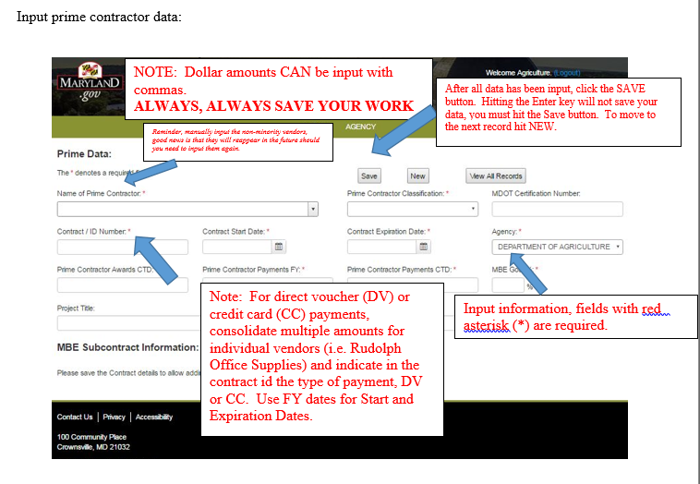
Form 3 Portal - Manual Entry
Reminder, manually input the non-minority vendors, good news is that they will reappear in the future should you need to input them again.
Governor’s Office of Small, Minority & Women Business Affairs

Slide 73
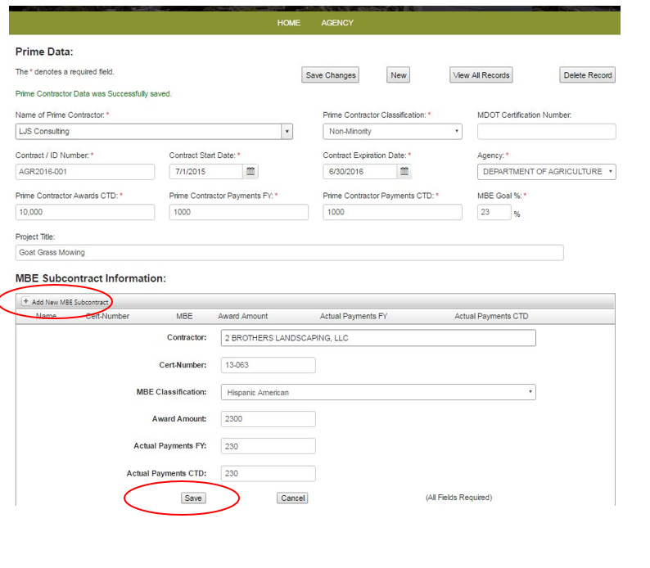
Form 3 Portal - Manual Entry
Add subcontractor data:
Click “Add MBE Subcontractor”
Input Subcontractor Data
Click SAVE
Note: If you can’t find an MBE in the drop down, search vendor in the MDOT Database https://mbe.mdot.maryland.gov/directory/
by certification number and confirm Vendor’s legal name.
There may be times when an MBE was decertified during the fiscal year. You can manually add them to the database but only count the payments for the time period they were certified. Contact MDOT certification group (410)-865-1269 for exact date of decertification.
Governor’s Office of Small, Minority & Women Business Affairs

Slide 74
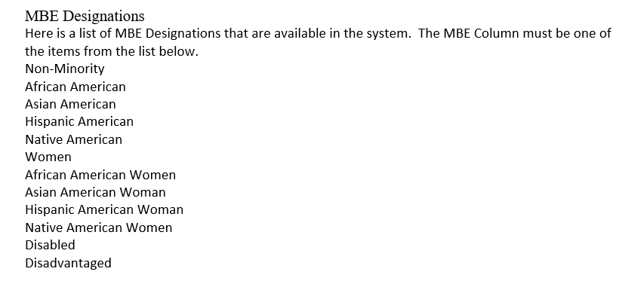
Form 3 Portal – Import Method
Use the Form 3 Data Template (Excel Sheet) found in the MBE Reporting Toolkit.
Fill in all requested information
Make sure that MBE Designations match the list in the Reporting Manual
Make sure that Prime IDs are unique for each contract , DV, or CC transaction
Be sure Prime ID matches subcontractors paid under that Contract
Governor’s Office of Small, Minority & Women Business Affairs

Slide 75
Form 3 Portal – Import Method
PRIMES TAB
  The Primes sheet should hold all the prime contractor information.
  It should contain a header row at the top
Columns are expected in order:
  ID
  Contractor Name
  EFIN
  MBE Designation
  MDOT Cert
  Contract#
  StartDate
  EndDate
  Award Amount
  Payments FY
  Payments CTD
  MBE Goal
  Description
Governor’s Office of Small, Minority & Women Business Affairs

Slide 76
Form 3 Portal – Import Method
PRIMES TAB (cont.)
  The ID column will not be stored in the database. It is just used to connect your subcontractors to their primes. You can use whatever naming convention you wish (Numbers or Letters). The ID’s just need to be unique for every Contract (so every Excel row should be unique). The suggestion is to use the contract # for contract awards.
  The optional columns are EFIN and Description. If you have this information, please provide it. The rest are required.
  For the MDOT Cert #, you can use a Zero or a blank for Non-Minority.
  For transactions that have no Start or End Date, you can use the Fiscal Year Start or end Dates.
  For transactions like Direct Vouchers and P-Card, you can use the FY payment data for other dollar fields, such as the Awards and payments CTD.
Governor’s Office of Small, Minority & Women Business Affairs

Slide 77
Form 3 Portal – Import Method
SUBS TAB
  The Subs sheet should hold all the sub-contractor information.
  This sheet should also contain a header row at the top.
Columns are expected in order:
  Prime ID (This should match the PRIME ID # for the contract the payment is for)
  Contractor Name
  MDOT Cert #
  MBE Designation
  Award Amount
  Payments FY
  Payments CTD
All columns are required
Governor’s Office of Small, Minority & Women Business Affairs

Slide 78
Form 3 Portal – Import Method
SUBS TAB (cont.)
  The Prime ID column will link the subs to their primes. The ID doesn’t need to be unique per row, but must match one row in the Primes sheet.
  Some data may not have all the information. Like P Card may not have Start or End Dates. These can be resolved by using some default data. This must be done for the system to be able to differentiate between data that actually has no value and data that was just forgotten.
  Default Data can include:
    Contractor Name – There is no default data that can be substituted. You need to type in the actual contractor name.
    MBE Designation – There is no default data that can be substituted. A valid MBE from the system must be input.
    MDOT Cert# – There is no default data that can be substituted. A valid MDOT Cert# should be provided.
    Start Date – For Credit Card payments, use the Fiscal Year Start Date.
    End Date – For Credit Card payments, use the Fiscal Year End Date.
    Award Amount & Payments – No default data, enter correct amounts.
Governor’s Office of Small, Minority & Women Business Affairs

Slide 79
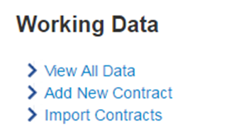

Form 3 Portal – Import Method
Import Instructions:
On the left hand menu under the “Working Data” section, choose the Import Contracts link. This will get you to the Import page. The link is as shown.
Once you arrive on the import page you will:
Select the Agency/Agency/Department from the dropdown list (if not already selected).
Click on the “Select a File To Upload” button. A dialog box will pop up for you to select which Excel file you want to upload. Only one file can be uploaded at a time.
Once a file has been selected and completely uploaded, click on the “Import Excel” button.
A “wait” icon will display while the file is being processed. If everything goes well, you will be greeted with the following message:
If instead you receive errors, resolve them, then try importing the Excel file again.
Should you need to edit your import data, you can edit the Excel file and reimport it.
Governor’s Office of Small, Minority & Women Business Affairs

Slide 80
Form 3 Portal – Import Method
Errors and Resolutions
  There are common errors that arise when importing the Form 3 Data Template.
  Each error will attempt to list which Excel sheet the error occurred in and the Unique Identifier used to identify which row.
  Also included should be the Column Name (if applicable) to identify the column.
  Each Error will be listed as a bulleted list item in red text.
  Don’t worry, if you encounter errors, no data in the system will be overwritten until all the errors are fixed.
Governor’s Office of Small, Minority & Women Business Affairs

Slide 81
Form 3 Portal – Import Method
Errors and Resolutions (cont.)
Governor’s Office of Small, Minority & Women Business Affairs

Slide 82
Form 3 Portal – Import Method
Errors and Resolutions (cont.)
Governor’s Office of Small, Minority & Women Business Affairs

Slide 83
Form 3 Portal – Import Method
Errors and Resolutions (cont.)
The above (Or a subset of) will appear whenever a required column has missing data (a blank cell). The error message will hold whether it was a Prime or subcontractor, the relevant ID string, and the column that is missing the data. Just add or fix the corresponding data column. For contracts that may not have some of the data, you can fill in default data. See the section above for default data for missing data (Ex. A P-Card might not have an end date).
Governor’s Office of Small, Minority & Women Business Affairs

Slide 84
Form 3 Portal – Reviewing Data
Once the manual entry or data import has been completed, you will can review and export the summary data.
The PRIME and Subcontractor summaries should be submitted with your final report
Governor’s Office of Small, Minority & Women Business Affairs

Slide 85
Form 3 Portal – Reviewing Data (cont.)
Governor’s Office of Small, Minority & Women Business Affairs

Slide 86
Form 3 Portal – Reviewing Data (cont.)
Governor’s Office of Small, Minority & Women Business Affairs

Slide 87
Form 3 Portal – Submitting Data
After review of data has been completed, you can submit data to GOSBA.
Both manual entries and template imports have to be submitted in the same manner.
Submitting the data makes it final. If there are issues after data has been submitted, please contact GOSBA, 410-697-9605.
Governor’s Office of Small, Minority & Women Business Affairs

Slide 88
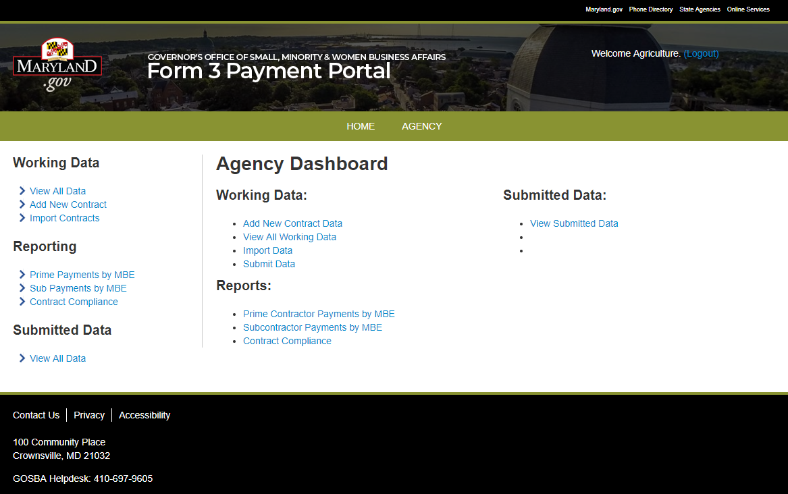

Form 3 Portal – Submitting Data (cont.)
Submitting data to GOSBA:
Click on Agency/Agency/Department (in the middle of top tool bar)
Under Working Data:
Click Submit Data
Chose Year
Click to Submit
You will get a confirmation message, Click OK
You should get this kind of message:
Governor’s Office of Small, Minority & Women Business Affairs

Slide 89
Contract Inventory Sheet
Pursuant to Senate Bill 849, passed during the 2010 General Assembly session and effective October 1, 2010, the Governor's Office of Small, Minority & Women Business Affairs is required to include in its annual report certain information on contracts awarded to MBE prime contractors and subcontractors. Instructions on completing the MBE Prime Contractors and MBE Subcontractors spreadsheets are as follows:
MBE Prime Contractors spreadsheet
  Number of MBE Prime Contractors: Enter the total number of different MBEs that were awarded prime contracts by the reporting agency/department.
  Agency/Agency/Department Name: Enter the name of the State Agency/Agency/Department reporting data.
  MBE Prime Contractor Name: Enter the name of each MBE prime contractor awarded a contract by the agency/department.
  Prime Contractor MBE Cert. #: For each MBE prime contractor, enter the MDOT MBE certification number. (Format: 00-000)
  Prime Contractor MBE Classification: For each MBE prime contractor, enter or select from the drop-down list the MBE classification. (African American, African American Woman, Asian, Hispanic, Native American, Woman, African American Woman, Asian Woman, Hispanic Woman, Native American Woman, Disabled, Disadvantaged)
  Agency/Agency/Department Contract #: For each MBE prime contractor, enter all prime contracts awarded. *IMPORTANT* Do include awards/payments made via corporate credit card or direct voucher (consolidate multiple payments per vendor).
Governor’s Office of Small, Minority & Women Business Affairs

Slide 90
Contract Inventory Sheet (cont.)
Contract Description (Procurement Category): For each MBE prime contract, enter or select from the drop-down list the contract description. For the purpose of this report, the contract description is the procurement category. Enter the appropriate procurement category: Architectural, Engineering; Construction; Construction Related Service; Maintenance; Service; Supplies & Equipment; IT Service; IT Supplies & Equipment; Human, Cultural, Social, & Educational Service.
Award Amount: Enter dollar value of award
Governor’s Office of Small, Minority & Women Business Affairs

Slide 91
Contract Inventory Sheet (cont.)
MBE Subcontractors spreadsheet
  Number of MBE Subcontractors: Enter the total number of different MBEs that were listed as subcontractors on prime contracts awarded by the reporting agency/department.
  Agency/Agency/Department Name: Enter the name of the State Agency/Agency/Department reporting data.
  MBE Subcontractor Name: Enter the name of each MBE subcontractor on a prime contract awarded by the agency/department. Include the names of MBE subcontractors on contracts awarded to non-MBE and MBE prime contractors.
Governor’s Office of Small, Minority & Women Business Affairs

Slide 92
Contract Inventory Sheet (cont.)
MBE Subcontractors spreadsheet
  Subcontractor MBE Cert. #: For each MBE subcontractor, enter the MDOT MBE certification number. (Format: 00-000)
  Subcontractor MBE Classification: For each MBE subcontractor, enter or select from the drop-down list the MBE classification. (African American, Asian, Hispanic, Native American, Woman, African American Woman, Asian Woman, Hispanic Woman, Native American Woman, Disabled, Disadvantaged)
  Agency/Agency/Department Prime Contract #: For each MBE subcontractor, enter the agency/department's prime contract number for all prime contracts awarded where there were one or more MBE subcontractors.
  Prime Contract Description (Procurement Category): For each MBE subcontract, enter or select from the drop-down list the prime contract description, as indicated in the MBE Prime Contractors spreadsheet section above.
  Award Amount: Enter dollar value of award.
Governor’s Office of Small, Minority & Women Business Affairs

Slide 93
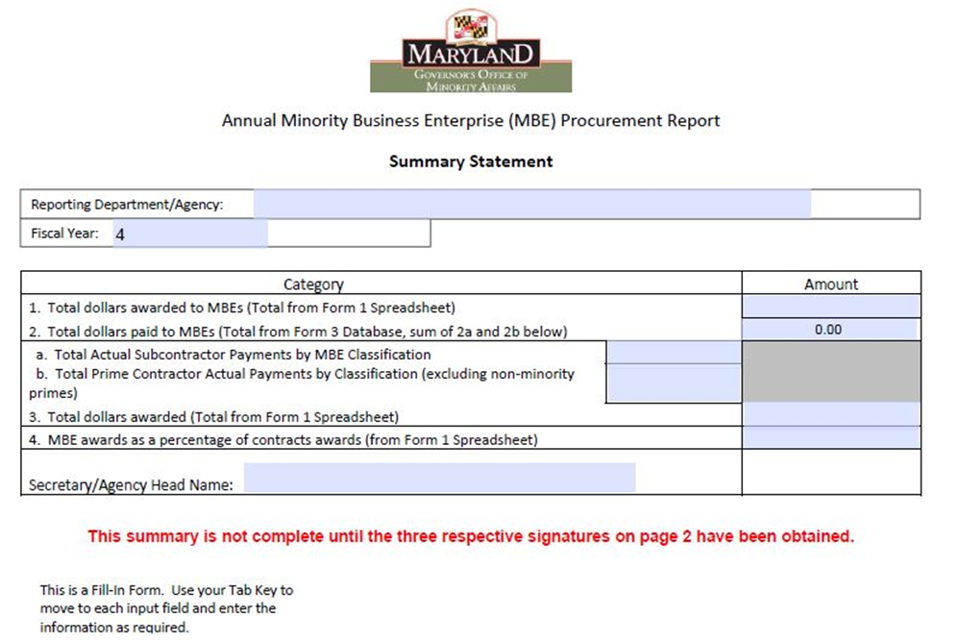
Annual MBE Summary Statement
The Summary Statement is a Fillable pdf.
Row #1 Input Total dollars awarded to MBEs (total from Form #1 Spreadsheet cell K23)
Row #2 Total dollars paid to MBEs is auto-populated from data input from 2a. and 2b.
2a. Input Total from FORM #3 Database “Subcontractor Information Report” plus,
2b. Input Total from FORM #3 Database “Prime Contractor Actual Payment by Classification Report” minus the amount for non-minority category, DO NOT ENTER COMMAS
Row #3 Input Total dollars awarded (Total from Form #1 Spreadsheet cell C23)
Row #4 Input MBE awards as a percentage of contract awards (from Form #1 Spreadsheet cell L23)
Page #2 OBTAIN Signatures of Report Preparer, Chief Financial Officer and Agency/Agency/Department Head
Governor’s Office of Small, Minority & Women Business Affairs

Slide 94
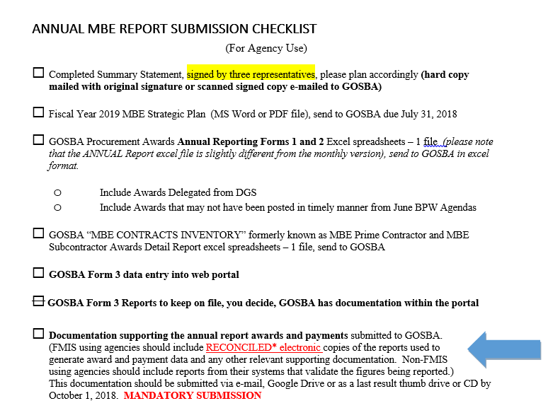
Use Your Checklist
Governor’s Office of Small, Minority & Women Business Affairs

Slide 95

Veteran-Owned Small Business Enterprise
(VSBE)
Tanita Johnson, SBR Compliance Manager
VSBE UPDATE
  Eligibility
  Registration
  Verification
  Reporting
  Vendor Search (Internal & External)
Governor’s Office of Small, Minority & Women Business Affairs

Slide 96


VSBE PROGRAM
(Veteran-Owned Small Business Enterprise)
-Provides contracting opportunities on state-funded procurements for qualified veteran-owned small businesses.
-Specific agencies spend at least 1% of the total dollar value of their procurement contracts either directly (prime contractors) or indirectly (subcontractors) with certified VSBE firms.

Slide 97
VSBE PROGRAM
VSBE Businesses must:
Meet size standards adopted by the United States Small Business Administration in 13 C.F.R. 121.201 and any subsequent revision of that regulation.
Be at least 51% owned and controlled by one or more individuals who are veterans.

Slide 98



VSBE PROGRAM
Certification within VSBE requires a vendor to:
1) Register within eMaryland Marketplace Advantage (eMMA)
2) Obtain Veteran Verification
(Maryland Department of Veterans Affairs OR U.S. Department of Veterans Affairs/Vetbiz)
3) Submit the eMMA VSBE Application

Slide 99
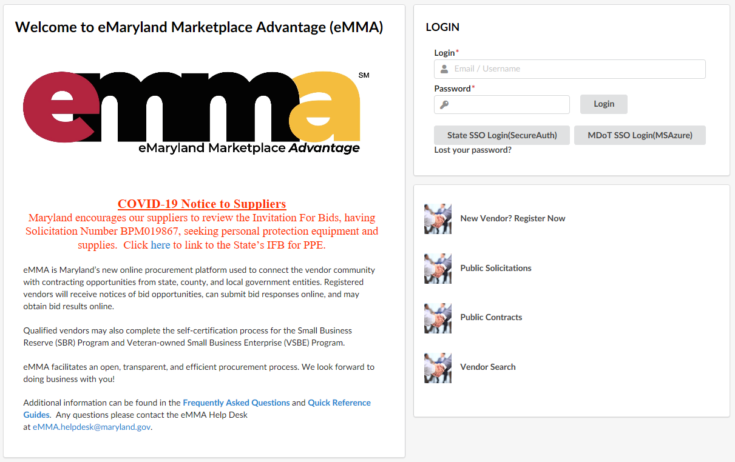
VSBE- Vendor Registration
1) Vendor must register within eMaryland Marketplace Advantage (eMMA)

Slide 100
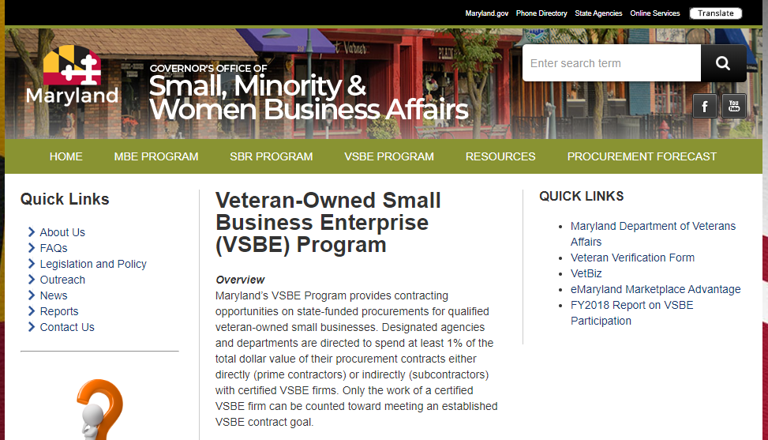
VSBE- Veteran Verification
2) Vendor must obtain Veteran Verification from the Maryland Department of Veterans Affairs OR U.S. Department of Veterans Affairs/Vetbiz.
Information can be found on gomdsmallbiz.maryland.gov.
(MDVA Form)
(Vetbiz Info)

Slide 101
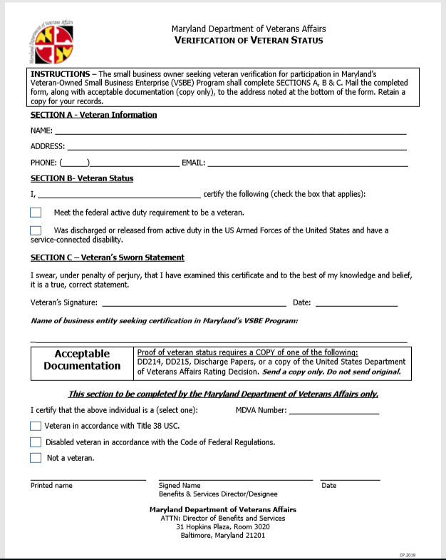
VSBE- Veteran Verification
If the vendor is verified as a Veteran, they will receive an MDVA# (i.e. MDVA2020-000), which will be used as the “VSBE Certification #” within their eMMA account.
MDVA Verification of Veteran Status Form
Vendor forwards this form to the MDVA to obtain Veteran verification.

Slide 102
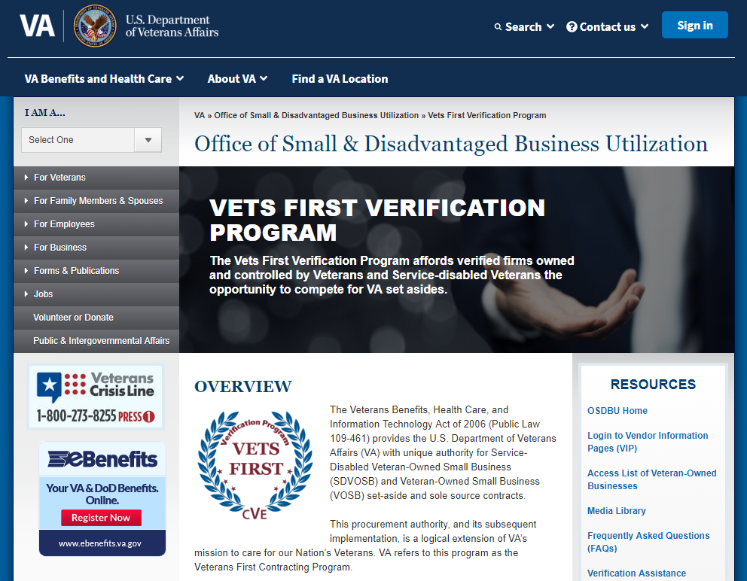
VSBE- Veteran Verification
Vetbiz Information
If the vendor decides to obtain Veteran Verification from the U.S. Department of Veterans Affairs/Vetbiz, they can visit this website for information- https://www.va.gov/osdbu/verification/.

Slide 103
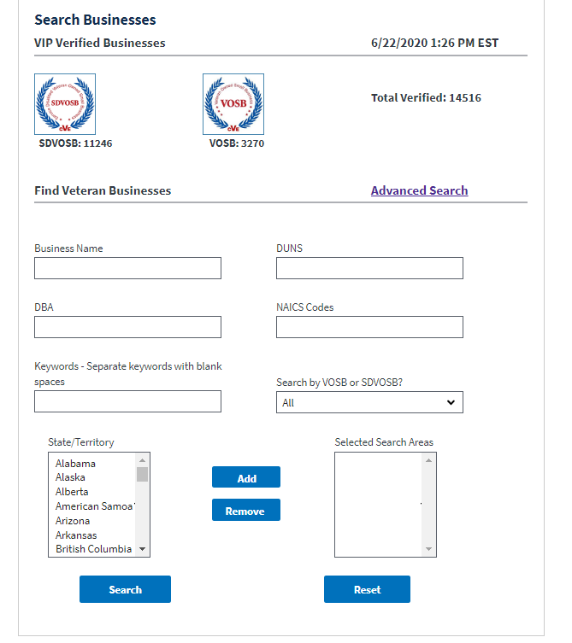
VSBE- Veteran Verification
Vetbiz Information
If the vendor already has a Vetbiz account that is current/valid, in which their DUNS# is found on https://vip.vetbiz.va.gov/, this DUNS# can be used for the Veteran verification (and listed within their eMMA account as the “VSBE Certification #”).

Slide 104
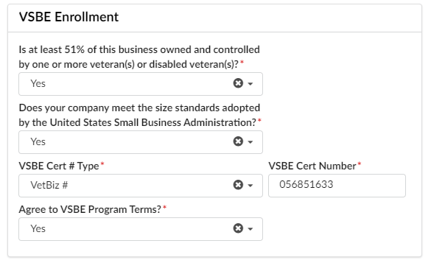
VSBE- eMMA VSBE Application
3) Vendor must submit the eMMA VSBE Application.
**Once the vendor has completed these 3 steps, the information will be reviewed to determine their VSBE Program certification status.

Slide 105
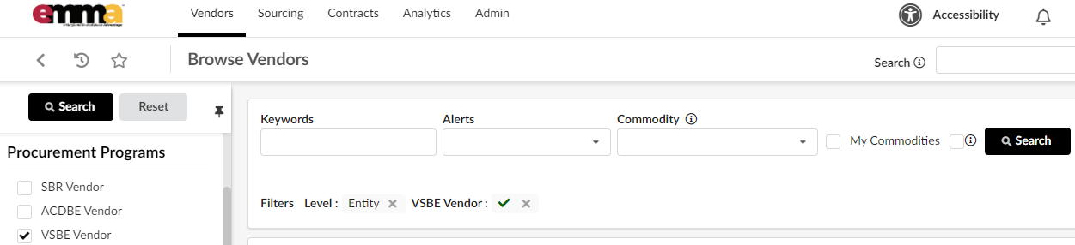
VSBE- Internal Vendor Search
VSBE vendors can be found by conducting an Internal Vendor Search in eMMA.

Slide 106
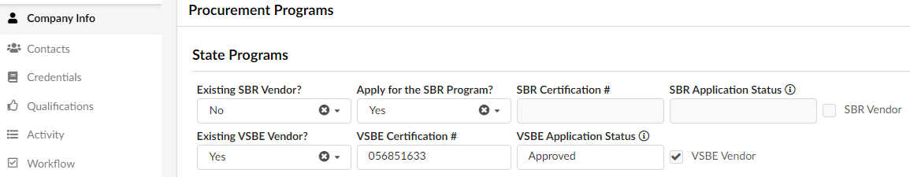
VSBE- Internal Vendor Search
To determine the VSBE certification status, click into the “Company Info” section of the vendor’s account. If the “VSBE Certification #” field has a DUNS# (9-digits, i.e. 123456789) OR MDVA# (12 alphanumeric characters, i.e. MDVA2020-000) listed AND ‘Approved’ in the “VSBE Application Status” field, this vendor is VSBE certified.

Slide 107
VSBE- External Vendor Search
You can also visit the eMMA website (https://emma.maryland.gov/) to perform a VSBE vendor search.

Slide 108
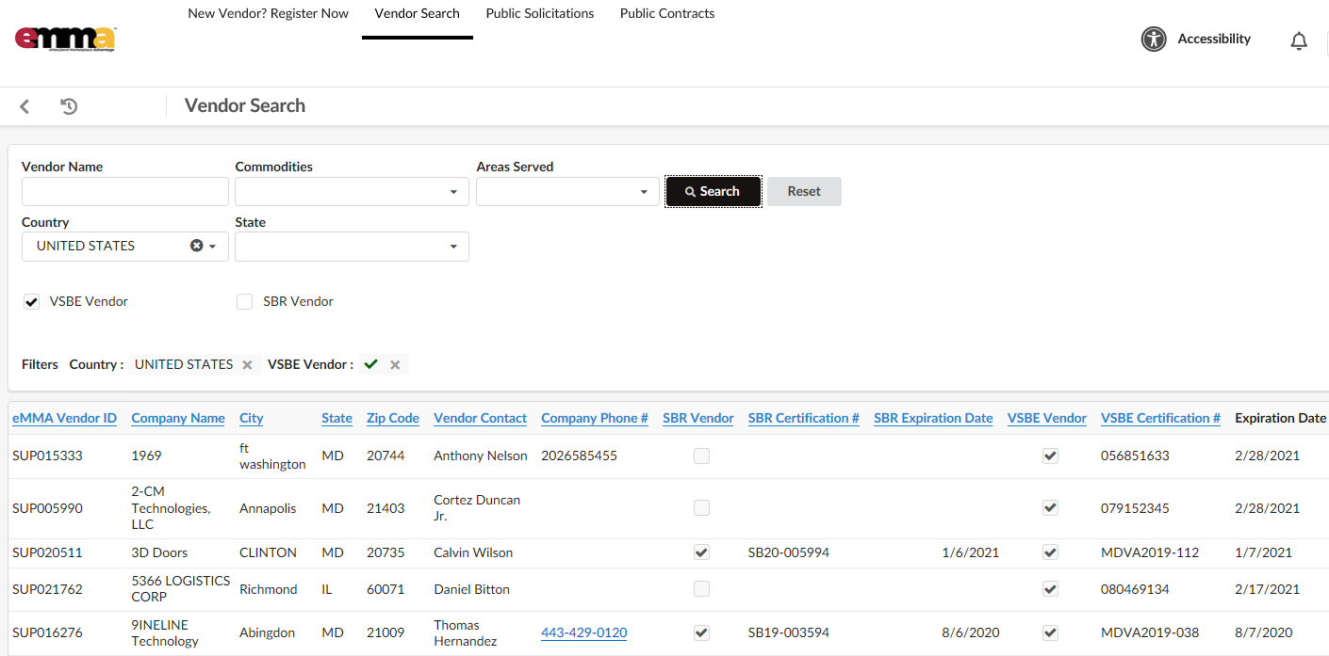
VSBE- External Vendor Search
You will find the “VSBE Certification #” and “Expiration Date” listed for the VSBE certified vendors.

Slide 109

VSBE Information
VSBE Reports are due on 10/1 annually
Regulations: COMAR 21.11.13.04 D
  “D. Procurement agencies shall use the forms and affidavits developed by the Governor's Office of Small, Minority, and Women Business Affairs for reporting procedures required by this title.”
VSBE Schedule E: Utilization Affidavit and Participation Schedule, are online: https://procurement.maryland.gov/rfp/ and should be completed similarly to MBE forms (COMAR 21.11.13.06)
Bidders can request VSBE waiver, if needed.
Governor’s Office of Small, Minority & Women Business Affairs

Slide 110
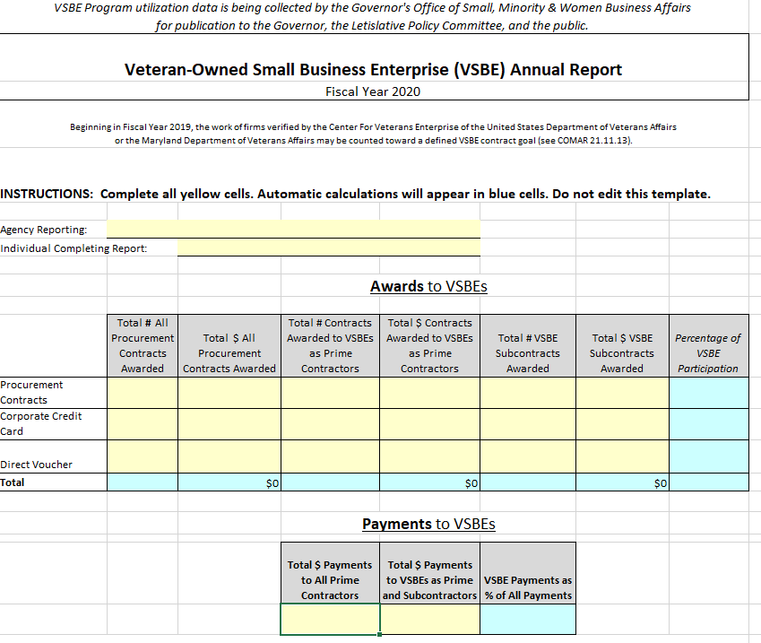
VSBE Reporting
VSBE Utilization Report
Governor’s Office of Small, Minority & Women Business Affairs

Slide 111

VSBE Reporting
Use data from the 700 series reports from ANSWERS or internal databases to capture VSBE payments and awards (will have to change the Report type to VET in answers , where appropriate.
At this time credit card payments cannot be tracked in ANSWERS, therefore, agencies will have to track these payments manually.
Total All Procurements column on the Annual Report Template should be identical to the Total All Procurements total for MBE Reporting.
As with MBE reporting, if a contract has a VSBE Prime and Sub, do not double count. The Prime Contractor total award should be listed; do not report the VSBE Subcontractor awards and payments on these contracts.
Governor’s Office of Small, Minority & Women Business Affairs

Slide 112
Announcements
Reminder: The Governor’s Office of Small, Minority & Women Business Affairs (GOSBA) has switched our reports and compliance mailboxes to match our new name.
  compliance.gosba@maryland.gov
    This mailbox is ONLY for certain required Reports , such as Procurement Forecasts, Strategic Plans, Waiver Determinations, Waiver Reports, etc.)
  mbereports.gosba@maryland.gov
    Submit all MBE Program reports here (such as MBE Quarterly and Annual Reports)
  sbrreports.gosba@maryland.gov
    Submit all SBR Program reports here (such as SBR Quarterly and Annual Reports)
  vsbereports.gosba@maryland.gov
    Submit all VSBE Program reports here (such as VSBE Annual Reports)
  vsbe.gosba@maryland.gov
    Submit VSBE Verification documents ONLY
Governor’s Office of Small, Minority & Women Business Affairs

Slide 113
Upcoming Training
Save the date!
SBR / MBE training (Virtual or In person – TBD):
  October 6, 2020
Governor’s Office of Small, Minority & Women Business Affairs

Slide 114

As always, if you have questions after todays training, please contact me:
Nichelle Johnson nichelle.johnson1@Maryland.gov
410-697-9605
Governor’s Office of Small, Minority & Women Business Affairs

Slide 115

QUESTIONS?
Governor’s Office of Small, Minority & Women Business Affairs

