Slide 1
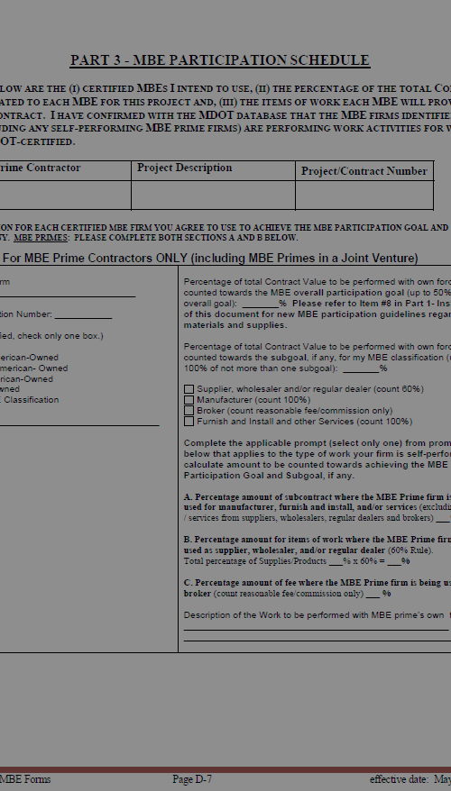
MBE Forms Training
Presented by the Governor’s Office of Small, Minority & Women Business Affairs

Slide 2
OUR AGENDA
This training will provide a detailed overview of the Attachment D: MBE Forms:
General Overview
MBE Utilization and Fair Solicitation Affidavit and MBE Participation Schedule
Waiver Guidance
Good Faith Efforts Documentation
Outreach Efforts Compliance Statement
Certified MBE Subcontractor Project Participation Certification
MBE Prime Project Participation Certification
Prime Contractor Paid/Unpaid Invoice Report
MBE Prime Contractor Report
MBE Subcontractor Paid/Unpaid Invoice Report

Slide 3
GENERAL OVERVIEW
For Internal Training Purposes Only

Slide 4
FY2021 MBE Performance
In FY2021, approximately 8,000 contracts totaling $1.1 Billion were awarded to Maryland Certified MBE firms

Slide 5
MBE Form Rules and Regulations
State Finance & Procurement Articles (SF&P) § 14-302. Procurement from minority businesses
COMAR 21.11.03.09
MBE Utilization and Fair Solicitation Affidavit & MBE Participation Schedule
COMAR 21.11.03.10-11
MBE Waiver Guidance & Forms
COMAR 21.11.03.10
MBE Project Participation Statements (Certifications)
COMAR 21.11.03.13
MBE Compliance Data – Payment Reports
Governor’s Office of Small, Minority & Women Business Affairs

Slide 6
IMPORTANT NOTE:
The latest MBE Forms are always located at the link below. Please make sure you are using the most recent version.
Located here: https://procurement.maryland.gov/rfp/
Some Agencies use their own approved version of the MBE forms such as MDOT and the School Districts for Public School Construction.
Governor’s Office of Small, Minority & Women Business Affairs

Slide 7
Form Requirements – Certified Firms
Only Certified MBE Firms can participate in the State's MBE Program and be named on these forms
“Certified MBE Firms” refers to firms certified by the Maryland Department of Transportation (“MDOT”) under COMAR 21.11.03.
Certified firms named on MBE forms should be verified in the MDOT Directory every time.
https://marylandmdbe.mdbecert.com/
Governor’s Office of Small, Minority & Women Business Affairs

Slide 8
Form Requirements
Form Requirements – Useful Function
Work performed by named MBE firms can only be counted if they are performing a commercially useful function [COMAR 21.11.03.12-1A/B]
Commercially useful function is defined as when a firm is responsible for execution of the work of the contract and is carrying out its responsibilities by actually performing, managing, and supervising the work involved
Governor’s Office of Small, Minority & Women Business Affairs

Slide 9
Form Requirements
Form Requirements – Useful Function
The Procurement Agency must evaluate the commercially useful function of each named certified MBE firm:
The amount of work subcontracted;
Industry practices;
Whether the amount the certified MBE is to be paid under the contract is commensurate with the work it is actually performing; and
If the MBE firm's role (1) is limited to less than 30% of awarded work or (2) is that of an extra participant on a contract
Governor’s Office of Small, Minority & Women Business Affairs

Slide 10
Form Requirements
Form Requirements – MBE Primes
Prime Contractors who are also MBE firms can self-perform 50% of the Overall MBE goal, and 100% of one subgoal [COMAR 21.11.03.12-1D]
When an MBE prime indicates their intent to self-perform a portion of subcontract goal(s):
Work to be self-performed must be covered by at least one of the MBE’s NAICS codes for which they are certified for in the MBE Directory
Governor’s Office of Small, Minority & Women Business Affairs

Slide 11
The 60% Rule
THE RATIONAL
In a narrowly tailored program, it is important that MBE credit be awarded only for work actually being performed by the MBEs themselves and that minority firms are actually getting the benefit
THE RULES
MBE firms named on contracts must serve a commercially useful function
MBE firms identified as Regular Dealers/Wholesalers or Brokers must be counted as outline in COMAR 21.11.03.12-1E
Governor’s Office of Small, Minority & Women Business Affairs

Slide 12
Understanding the 60% Rule
Chapter 438, Laws of Maryland 207 (SB 309)
Became effective Oct. 1, 2017
Mirrors Federal DBE rules, which define how work performed by DBE suppliers will be counted towards the overall project goal
Discusses 3 Supplier Classifications:
MANUFACTURERS
REGULAR DEALERS/ AND OR WHOLESALERS
*FURNISH & INSTALL & OTHER SERVICES*
BROKERS
Governor’s Office of Small, Minority & Women Business Affairs

Slide 13
Manufacturers
100% of materials or supplies obtained from an MBE manufacturer, may be counted toward MBE goal achievement
What is a manufacturer?
A firm that operates or maintains a factory or establishment that produces, on the premises, the material, supplies, articles or equipment required under the contract
Governor’s Office of Small, Minority & Women Business Affairs

Slide 14
Regular Dealer
60% of the material or supplies purchased from a regular dealer count toward the project’s overall MBE goal
What is a regular dealer?
A firm that owns, operates, or maintains a store, warehouse, or establishment, in which the materials, supplies articles or equipment of the general character described by the specifications and required under the contract are bought, kept in stock, and regularly sold or leased to the public in the usual course of business.
Governor’s Office of Small, Minority & Women Business Affairs

Slide 15
Furnish & Install or Other Services
Where an MBE supplier, wholesaler, regular dealer, both provides (i.e., furnishes) AND installs the materials, 100% of the cost of the materials, supplies and labor will count toward the MBE goals.
EXAMPLE
PAINTER SUPPLIER – a wholesale merchant, who maintains a warehouse where he/she regularly keeps in stock and sells paint to prime contractors. Only 60% of the spend with this PAINT SUPPLIER can be counted toward the overall goal of the project
PAINTER that PAINTS- same scenario as above, except the painter, in additional to selling the paint from their warehouse, will be responsible for doing the actual painting. In this case, we would count 100% of the cost of the material, supplies, and the labor toward the MBE project goal.
Governor’s Office of Small, Minority & Women Business Affairs

Slide 16
Broker
Count the entire amount of:
fees or commissions charged for assistance in the procurement of the materials and supplies; or
fees of transportation charges for delivery of materials or supplies required on job site
Caveat
Fees must be reasonable and not excessive as compared with fees customarily allowed for similar services
Do not count any portion of the cost of materials or supplies themselves
Governor’s Office of Small, Minority & Women Business Affairs

Slide 17
MBE Utilization and Fair Solicitation Affidavit & MBE Participation Schedule
For Internal Training Purposes Only

Slide 18
Regulations
COMAR Sec. 21.11.03.09 C Procurement Solicitations
(3) On forms provided by the procurement agency, a bidder or offeror shall submit with its bid or proposal:
(a) A completed MBE utilization and fair solicitation affidavit including either an agreement to meet the certified MBE participation goal or a request for a full or partial waiver; and
(b) A completed MBE participation schedule that identifies the certified minority businesses that the bidder or offeror agrees to utilize in the performance of the contract and the percentage of contract value attributed to each MBE.
(4) The MBE participation schedule shall:
(a) Include the name of each certified MBE that will participate in the project including the certification category under which the MBE is participating; and
(b) Include the percentage of the contract to be paid to each MBE for the work or supply.
(5) The failure of a bidder to accurately complete and submit the MBE utilization affidavit and the MBE participation schedule shall result in a determination that the bid is not responsive unless the inaccuracy is determined to be the result of a minor irregularity that is waived or cured in accordance with COMAR 21.06.02.04.
(6) The failure of an offeror to accurately complete and submit the MBE utilization affidavit and the MBE participation schedule shall result in a determination that the proposal is not reasonably susceptible of being selected for award unless the inaccuracy is determined to be the result of a minor irregularity that is waived or cured in accordance with COMAR 21.06.02.04.
Governor’s Office of Small, Minority & Women Business Affairs

Slide 19
MBE Utilization and Fair Solicitation Affidavit & MBE Participation Schedule
SUBMISSION:
Prime Contractors must utilize the forms that are provided in the solicitation documents
Forms must be submitted with the bid/proposal
Failure to submit these forms results in the rejection of bid/proposal
Failure to submit completed or accurate forms requires the agency to determine if minor irregularities can be cured [COMAR 21.06.02.04]
Governor’s Office of Small, Minority & Women Business Affairs

Slide 20
MBE Utilization and Fair Solicitation Affidavit & MBE Participation Schedule
COMAR 21.06.02.04: Minor Irregularities in Bids or Proposals.
A minor irregularity is one which is merely a matter of form and not of substance or pertains to some immaterial or inconsequential defect or variation in a bid or proposal from the exact requirement of the solicitation, the correction or waiver of which would not be prejudicial to other bidders or offerors.
The defect or variation in the bid or proposal is immaterial and inconsequential when its significance as to price, quantity, quality, or delivery is trivial or negligible when contrasted with the total cost or scope of the procurement.
The procurement officer shall either give the bidder or offeror an opportunity to cure any deficiency resulting from a minor informality or irregularity in a bid or proposal or waive the deficiency, whichever is to the advantage of the State.
Agency’s MBE liaison officer and legal counsel should be consulted on minor irregularity determinations and waiver issues prior to seeking Governor's Office of Small, Minority & Women Business Affairs weigh in.
Governor’s Office of Small, Minority & Women Business Affairs

Slide 21
MBE Utilization and Fair Solicitation Affidavit & MBE Participation Schedule
GENERAL REQUIREMENTS:
Must indicate the Primes clear intent to either meet the goal or request either a full or partial waiver of the MBE goal and/or subgoals
Must provide specific commitment to each named MBE
Must describe the specific work each MBE will perform
Must list only active fully certified MBE firms listed in the MBE Directory hosted by MDOT. Take special note of graduated firms.
Governor’s Office of Small, Minority & Women Business Affairs

Slide 22
MBE Utilization and Fair Solicitation Affidavit & MBE Participation Schedule
WHAT IS GRADUATION?
The term "GRADUATED" means a firm has exceeded the allowable industry size standard set for MBE/DBE participants and may no longer be counted as an MBE/DBE on state or federal contracts for work performed in this category.
US Small Business Size Standards: https://www.sba.gov/federal-contracting/contracting-guide/size-standards
Graduation is outlined in COMAR 21.11.03.15
Governor’s Office of Small, Minority & Women Business Affairs

Slide 23
MBE Utilization and Fair Solicitation Affidavit & MBE Participation Schedule
WHAT IS GRADUATION?
Certified MBE firms may be fully or partially graduated.
Graduation is the recognition that a firm has attained a fiscally significant presence in the marketplace. Firms are reviewed annually and are assigned a graduate status for any NAICS code that relates to an industry in which the firm is proven to have exceeded the allowable MBE/DBE participant revenue threshold. Firms may also graduate as a whole entity if the personal net worth (PNW) of the owner exceeds the allowable maximum for MBE/DBE program participants.
Governor’s Office of Small, Minority & Women Business Affairs

Slide 24
MBE Utilization and Fair Solicitation Affidavit & MBE Participation Schedule
FULLY GRADUATED VS PARTIALLY GRADUATED
Fully Graduated Firms - have exceeded the size standard for all of their assigned NAICS code or exceeded the personal net worth (PNW) threshold set for MBE/DBE program participants. Fully graduated firms may not be used for state and/or federal MBE/DBE procurement purposes.
Partially Graduated Firms - have one or more graduated NAICS codes but have at least one assigned NAICS code for which they are not graduated. Only non-graduated codes may be used for state and/or federal MBE/DBE procurement purposes.
Governor’s Office of Small, Minority & Women Business Affairs

Slide 25
MBE Utilization and Fair Solicitation Affidavit
PART 2 - MBE UTILIZATION AND FAIR SOLICITATION AFFIDAVIT
1. MBE Participation (PLEASE CHECK ONLY ONE)
☐ I acknowledge and intend to meet IN FULL both the overall certified Minority Business
Enterprise (MBE) participation goal of percent and all of the following subgoals:
____percent for African American-owned MBE firms
____percent for Hispanic American-owned MBE firms
____percent for Asian American-owned MBE firms
____percent for Women-owned MBE firms
Therefore, I am not seeking a waiver pursuant to COMAR 21.11.03.11. I acknowledge that by checking the above box and agreeing to meet the stated goal and subgoal(s), if any, I must complete PART 3 - MBE Participation Schedule and Part 4 Signature Page in order to be considered for award.
OR
☐ After making good faith outreach efforts prior to making this submission, I conclude that I am unable to achieve the MBE participation goal and/or subgoals. I hereby request a waiver, in whole or in part, of the overall goal and/or subgoals I acknowledge that by checking this box and requesting a partial waiver of the stated goal and/or one or more of the stated subgoal(s) if any, I must complete Part 3, the MBE Participation Schedule and Part 4 Signature Page for the portion of the goal and/or subgoal(s) if any, for which I am not seeking a waiver, in order to be considered for award. I acknowledge that by checking this box and requesting a full waiver of the stated goal and the stated subgoal(s) if any, I must complete Part 4 Signature Page in order to be considered for award.
Governor’s Office of Small, Minority & Women Business Affairs

Slide 26
MBE Participation Schedule
D7
D8
Governor’s Office of Small, Minority & Women Business Affairs

Slide 27
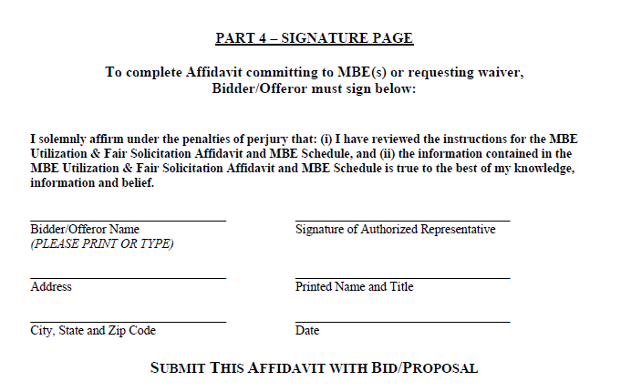
MBE Participation Schedule (cont.)
D10
Governor’s Office of Small, Minority & Women Business Affairs

Slide 28
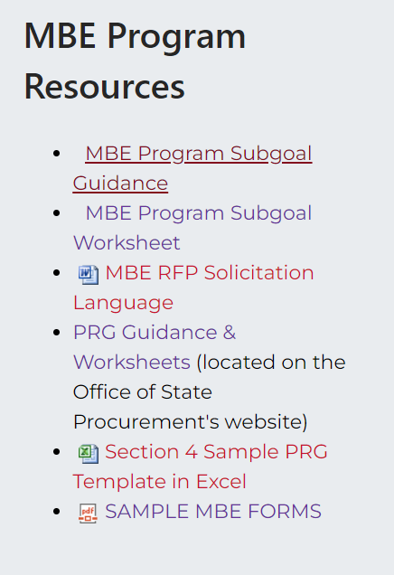
MBE Form Samples
Updated MBE Form Samples are located on our website in the MBE toolkit in the MBE Program Resources Section:
Let's look at a few EXAMPLES.

Slide 29
WAIVER GUIDANCE
For Internal Training Purposes Only

Slide 30
Waiver Guidance and Good Faith Efforts Documentation
Waiver Guidance - lays out main criteria used to determine good faith efforts
Considers quality, quantity and intensity of bidder’s efforts
Does not cover all factors state may consider
Guidance covered on pp. D11 – D14 of MBE Attachment D
Good Faith Effort Documentation - must be submitted within 10 working days of request from the state
A copy of waiver, when granted, should be forwarded to our office
Waiver data is to be reported annual to the Board of Public Works and our office by July 31st annually
Governor’s Office of Small, Minority & Women Business Affairs

Slide 31
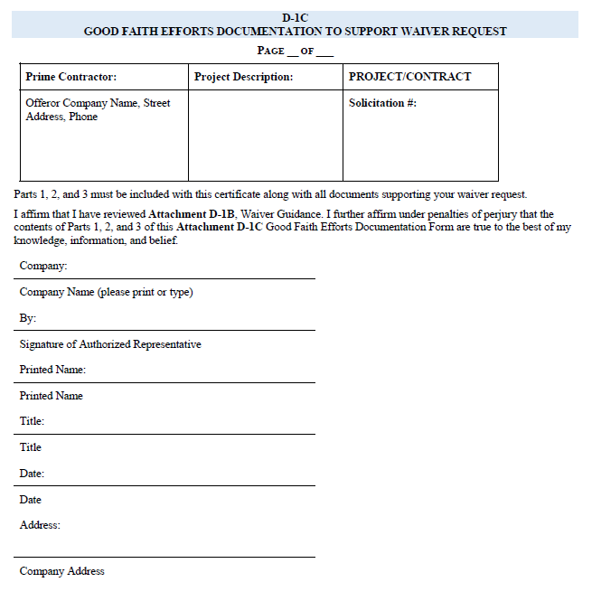
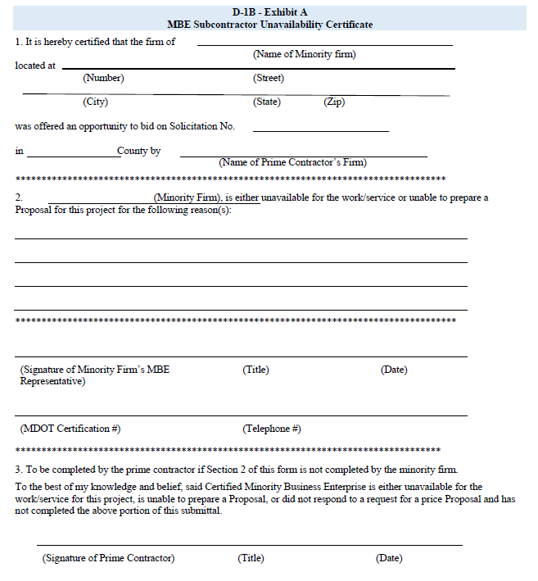
Waiver Documentation
D15
D16
Governor’s Office of Small, Minority & Women Business Affairs

Slide 32
GOOD FAITH EFFORTS DOCUMENTATION
For Internal Training Purposes Only

Slide 33
Good Faith Efforts Documentation
Consider COMAR 21.11.03.09C(2) when considering if a “Good Faith Effort” was made:
C. MBE Subcontracting Provisions
(2) Solicitation Content. Each solicitation identified by a procurement agency as having subcontract opportunities shall contain the clauses required by COMAR 21.05.08.03 and .04. The solicitation shall also contain provisions requiring bidders or offerors including those bidders or offerors that are certified MBEs to:
(a) Identify specific work categories within the scope of the procurement appropriate for subcontracting;
(b) Solicit certified MBEs in writing at least 10 days before bids or proposals are due, describing the identified work categories and providing instructions on how to bid on the subcontracts;
(c) Attempt to make personal contact with the certified MBEs solicited and to document these attempts;
(d) Assist certified MBEs to fulfill, or to seek waiver of, bonding requirements; and
(e) Attend prebid or other meetings the procurement agency schedules to publicize contracting opportunities to certified MBEs.
Governor’s Office of Small, Minority & Women Business Affairs

Slide 34
Good Faith Efforts Documentation
Good Faith Efforts Documentation should include:
The names, addresses, dates, telephone numbers, and classification of certified MBEs contacted
A detailed statement of the reasons for rejected quotations from certified MBE firms
Emails & phone contact records
Any other records of negotiations with MBE firms
Governor’s Office of Small, Minority & Women Business Affairs

Slide 35
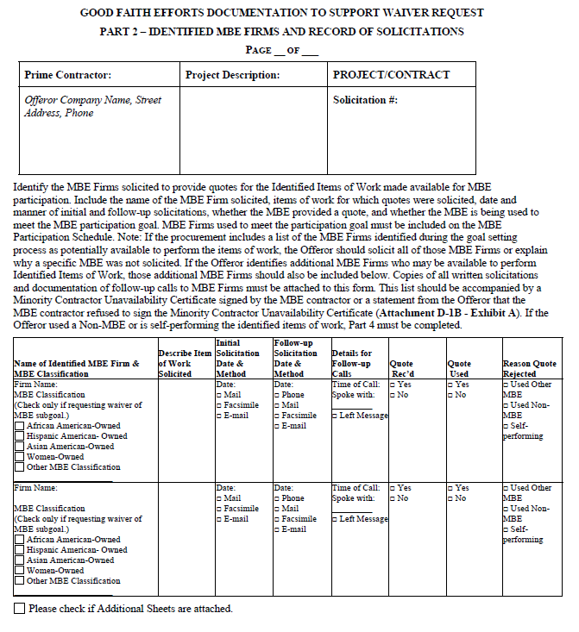
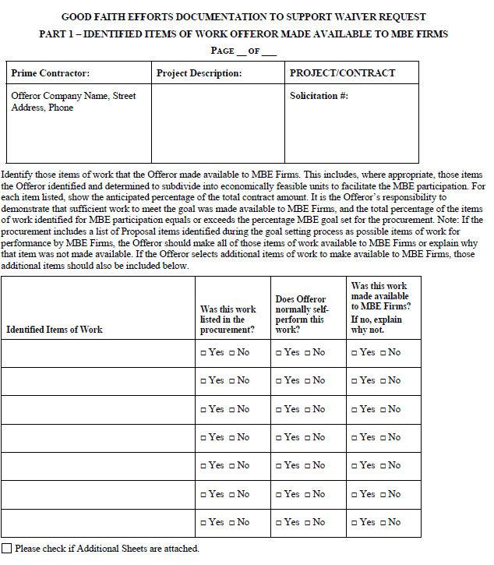
Good Faith Efforts Documentation (cont.)
D17
D18
Governor’s Office of Small, Minority & Women Business Affairs

Slide 36
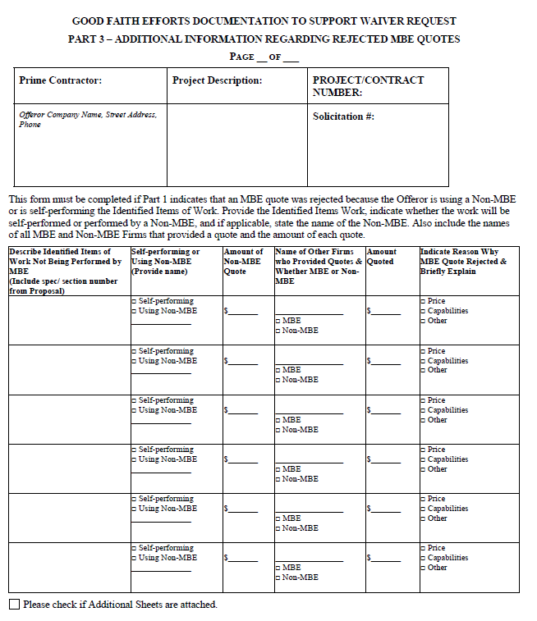
Good Faith Efforts Documentation (cont.)
D19
Governor’s Office of Small, Minority & Women Business Affairs

Slide 37
Outreach Efforts Compliance Statement
Not required to be submitted with bid/offer
Requested from procurement officer in connection with notice of intent to award
Asks for bidder’s MBE outreach efforts and attempts made to assist MBE subcontractors
Reasonable timeframe to submit (10 working days)
Failure to submit this form could result in withdrawal of offer (see pg. 5 of Affidavit)
Governor’s Office of Small, Minority & Women Business Affairs

Slide 38
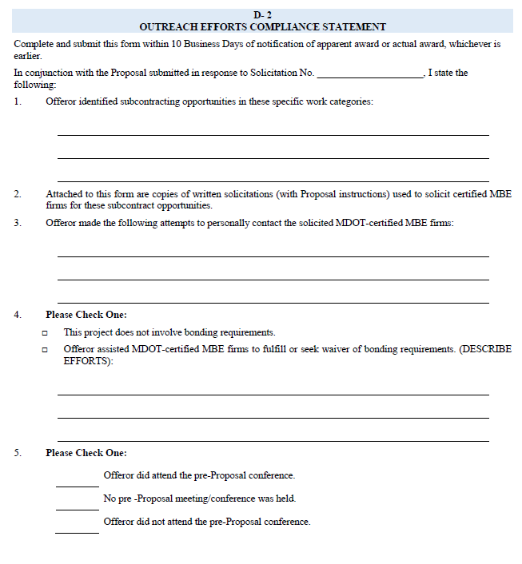
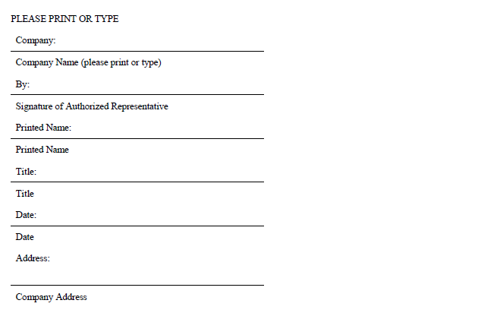
Outreach Efforts Compliance Statement (cont.)
D20
D21
Governor’s Office of Small, Minority & Women Business Affairs

Slide 39
Certified MBE Subcontractor Project Participation Certification
For Internal Training Purposes Only

Slide 40
MBE Project Participation Certifications
MBE Subcontractor Project Participation Certification
Must be submitted for each named MBE within 10 working days
Prime must complete sections A, B, & D before presenting to subcontractor for signature, note the fraud provisions on this form
MBE names, dollar amounts, percentages, and work descriptions must be consistent with Participation Schedule
Subcontractors should verify information on form before signing it; and finalize their Subcontract Agreement
Procurement officer and MBE liaison should answer questions, if any arise
A copy should be held by the Subcontractor, with one copy sent to the Prime, and the original sent to the Agency directly NOT THROUGH THE PRIME
Governor’s Office of Small, Minority & Women Business Affairs

Slide 41
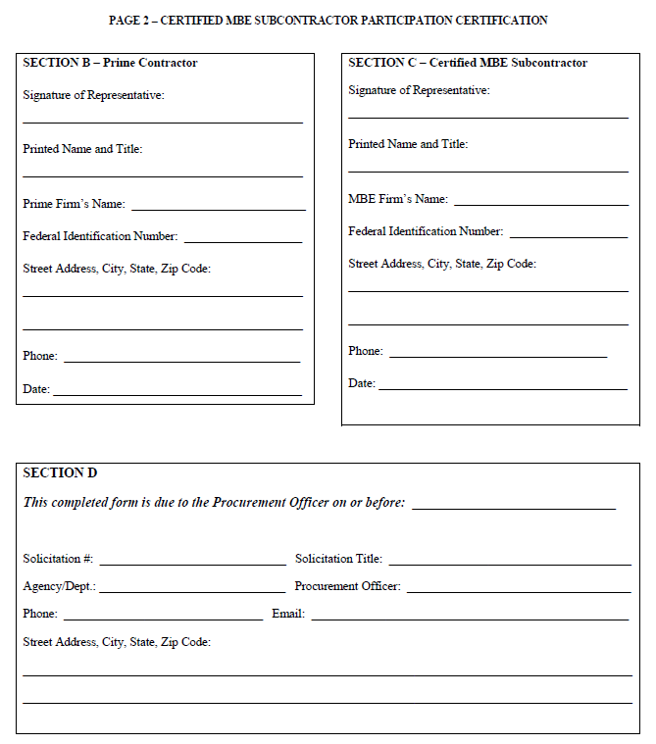
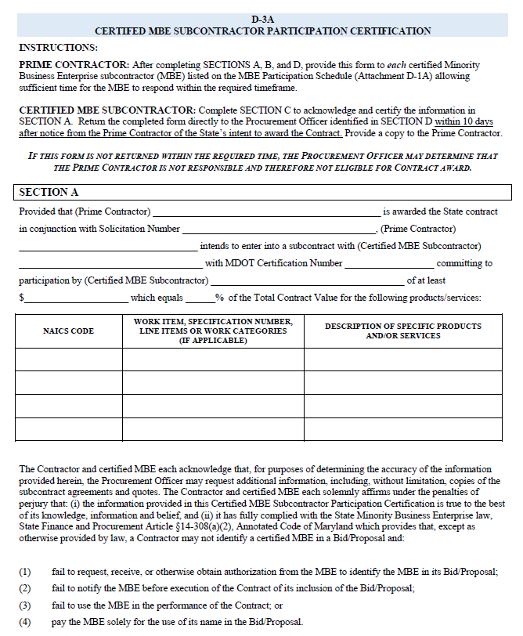
MBE Subcontractor Project Participation Certification
D22
D23
Governor’s Office of Small, Minority & Women Business Affairs

Slide 42
MBE Project Participation Certifications
For Internal Training Purposes Only

Slide 43
MBE Project Participation Certifications
MBE Prime Project Participation Certifications
Separate attestation for MBE prime self-performance
Entries here must be consistent with Affidavit/Schedule
Confirms that a specified percentage of work will be performed by MBE prime’s own workforce
Work must be within NAICS codes and fulfill commercially useful function
Subject to confirmation via field inspections, office visits, etc.
Governor’s Office of Small, Minority & Women Business Affairs

Slide 44
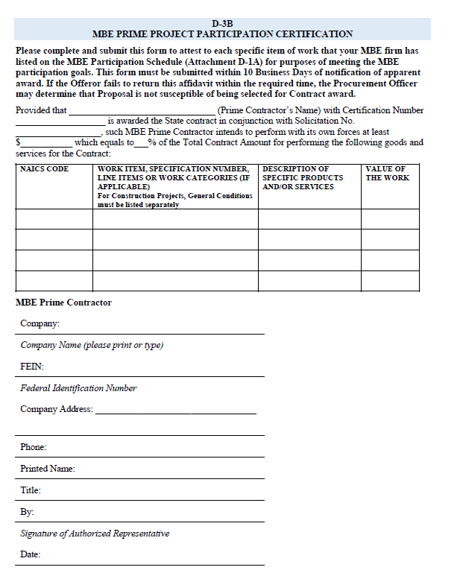
MBE Participation Certification
D24
Governor’s Office of Small, Minority & Women Business Affairs

Slide 45
MBE Compliance - Payment Reports
For Internal Training Purposes Only

Slide 46
Prime Contractor Paid/Unpaid Invoice Report
Required per COMAR 21.11.03.13
This form is to submitted by the Prime Contractor
The form is submitted monthly for each MBE subcontractor named on the contract
Reports all payments made to the named MBE subcontractor during the reporting period
Reports any outstanding invoices for the MBE subcontractor
Governor’s Office of Small, Minority & Women Business Affairs

Slide 47
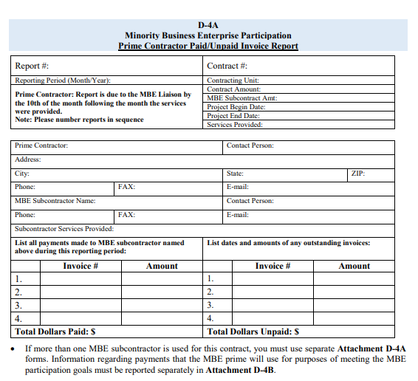
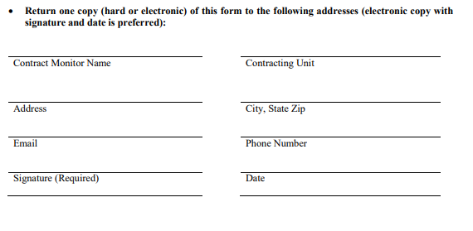
Prime Contractor Paid/Unpaid Invoice Report
D25
Governor’s Office of Small, Minority & Women Business Affairs

Slide 48
MBE Prime Contractor Report
Required per COMAR 21.11.03.13
This form is to submitted only by an MBE Prime Contractor, if they are self performing
The form is submitted monthly
Reports all payments made to the MBE Prime contractor during the reporting period which count towards the MBE goal
Governor’s Office of Small, Minority & Women Business Affairs

Slide 49
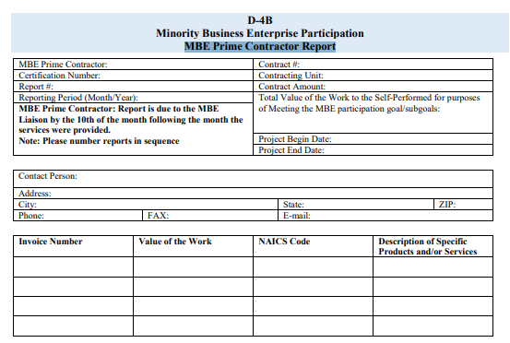
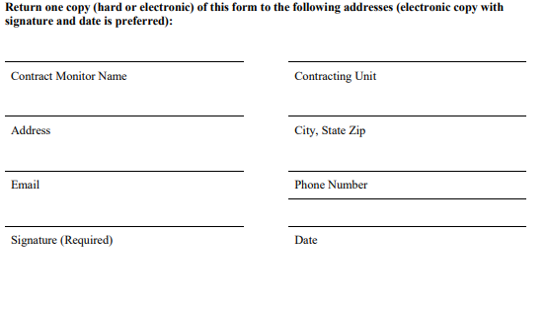
MBE Prime Contractor Report
D26
Governor’s Office of Small, Minority & Women Business Affairs

Slide 50
MBE Subcontractor Paid/Unpaid Invoice Report
Required per COMAR 21.11.03.13
This form is to submitted by each MBE subcontractor on the contract
The form is submitted monthly
Reports all payments made to the MBE subcontractor during the reporting period
Reports any unpaid invoices owed to the MBE subcontractor which are over 30 days old
Governor’s Office of Small, Minority & Women Business Affairs

Slide 51
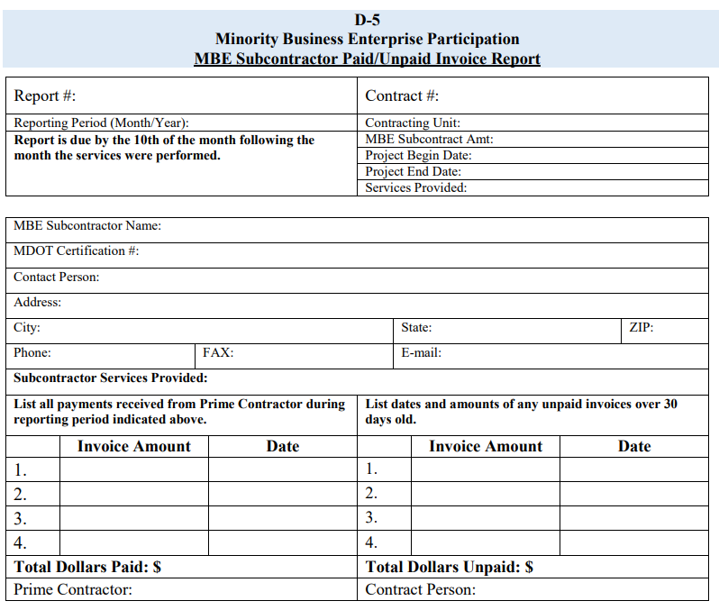
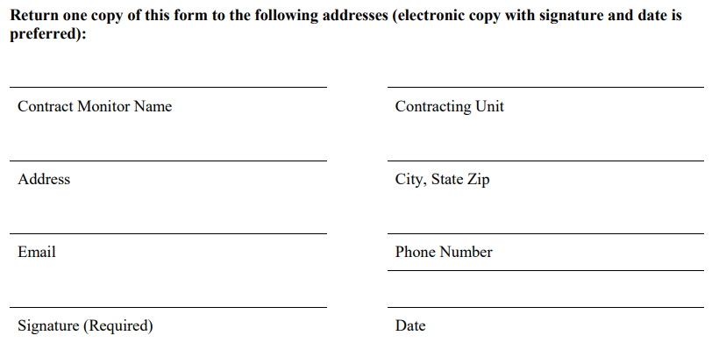
MBE Subcontractor Paid/Unpaid Invoice Report
D27
Governor’s Office of Small, Minority & Women Business Affairs

Slide 52
MBE FORMS – SPECIAL CONSIDERATIONS
For Internal Training Purposes Only

Slide 53
SUB-TIER SUBCONTRACTORS
THIRD TIER CONTRACTING is defined in the MBE Manual as - the process in which a prime contractor subcontracts a portion of an original contract to a subcontractor who in turn subcontracts a portion of a subcontract to a third party. This latter action is termed entering into a third-tier contract.
Third tier contracting is not the usual way for a prime contractor to achieve a DBE/MBE goal , therefore MBE forms are not actually formatted for third tier contracting.
If approved, the agency/department must determine how the MBE forms will be used to capture the third-tier contractor’s information at bid, at award, and during the life of the contract.

Slide 54
SUB-TIER SUBCONTRACTORS
The agency/department that approves third tier contracting on a contract must be satisfied that there is no other way to achieve the DBE/MBE goal, except by third tier contracting AND
The prime contractor should request this approval in writing with an explanation of why third tier contracting is being requested
Approval by the agency /department should be provided in writing and should outline the terms/parameters of the third-tier contract.

Slide 55
Amendment of MBE Forms
Per COMAR 21.11.03.12
72 Hour rule: After bid/proposal submission and before execution of contract
Certified MBE becomes ineligible or unavailable to perform
Bidder/Offeror notifies PO within 72 hours of determination
Bidder/Offeror request MBE form amendment within 5 days of determination
Governor’s Office of Small, Minority & Women Business Affairs

Slide 56
Amendment of MBE Forms
Per COMAR 21.11.03.12
“Good Cause” termination/cancellation: After contract award
Certified MBE has documented nonperformance or elected to cease work
Agency legal counsel should be consulted for additional reasons for termination
Requires written consent of MBE liaison and approval of unit head
Copy of written consent should go to Governor’s Office of Small, Minority & Women Business Affairs
Governor’s Office of Small, Minority & Women Business Affairs

Slide 57
Wrap Up
The accuracy of MBE forms and reports directly affects the successful award of contracts with MBE goals , MBE Contract compliance, and achievement of MBE goals.
As a stakeholder in the MBE space, you have the power to ensure that the MBE Program is executed successfully within your agency.
Share your knowledge of how to accurately complete MBE forms with both Prime and subcontractors often at Pre-bid meetings, outreach events, and even one on one.
Governor’s Office of Small, Minority & Women Business Affairs

Slide 58
If you have any questions, after today’s training please contact your designated MBE Compliance Manager.
Compliance Managers:
Nichelle Johnson
Nichelle.johnson1@Maryland.gov
(410) 697-9605
(667) 232-1369
Karen Reyes
Karen.reyes@maryland.gov
(410) 697-9608
(443) 346-0630
GOSBA Office Number:
(410) 697-9600

